Slide 1
Chapter 19 Searching, Sorting and Big O
Java How to Program, 11/e

Slide 2
Course Objectives
Understand and implement various data structures (List, Trees, etc.).
Utilize different sort and search algorithms.

Slide 3
Chapter Objectives
Describe how to search for a given value in an array using linear search and binary search algorithms.
Describe how to sort arrays using the iterative selection sort, insertion sort and recursive merge sort algorithms.
Determine the efficiency of searching and sorting algorithms.
Identify the Big O notation for comparing the efficiency of algorithms.

Slide 4
19.1 Introduction
Searching data involves determining whether a value (referred to as the search key) is present in the data and, if so, finding its location.
Two popular search algorithms are the simple linear search and the faster but more complex binary search.
Sorting places data in ascending or descending order, based on one or more sort keys.
This chapter introduces two simple sorting algorithms, the selection sort and the insertion sort, along with the more efficient but more complex merge sort.

Slide 5
19.2 Linear Search
The linear search algorithm searches each element in an array sequentially.
If the search key does not match an element in the array, the algorithm tests each element, and when the end of the array is reached, informs the user that the search key is not present.
If the search key is in the array, the algorithm tests each element until it finds one that matches the search key and returns the index of that element.
Class LinearSearchTest (Fig. 19.2) contains
static method linearSearch for performing searches of an int array.
main for testing linearSearch.

Slide 6
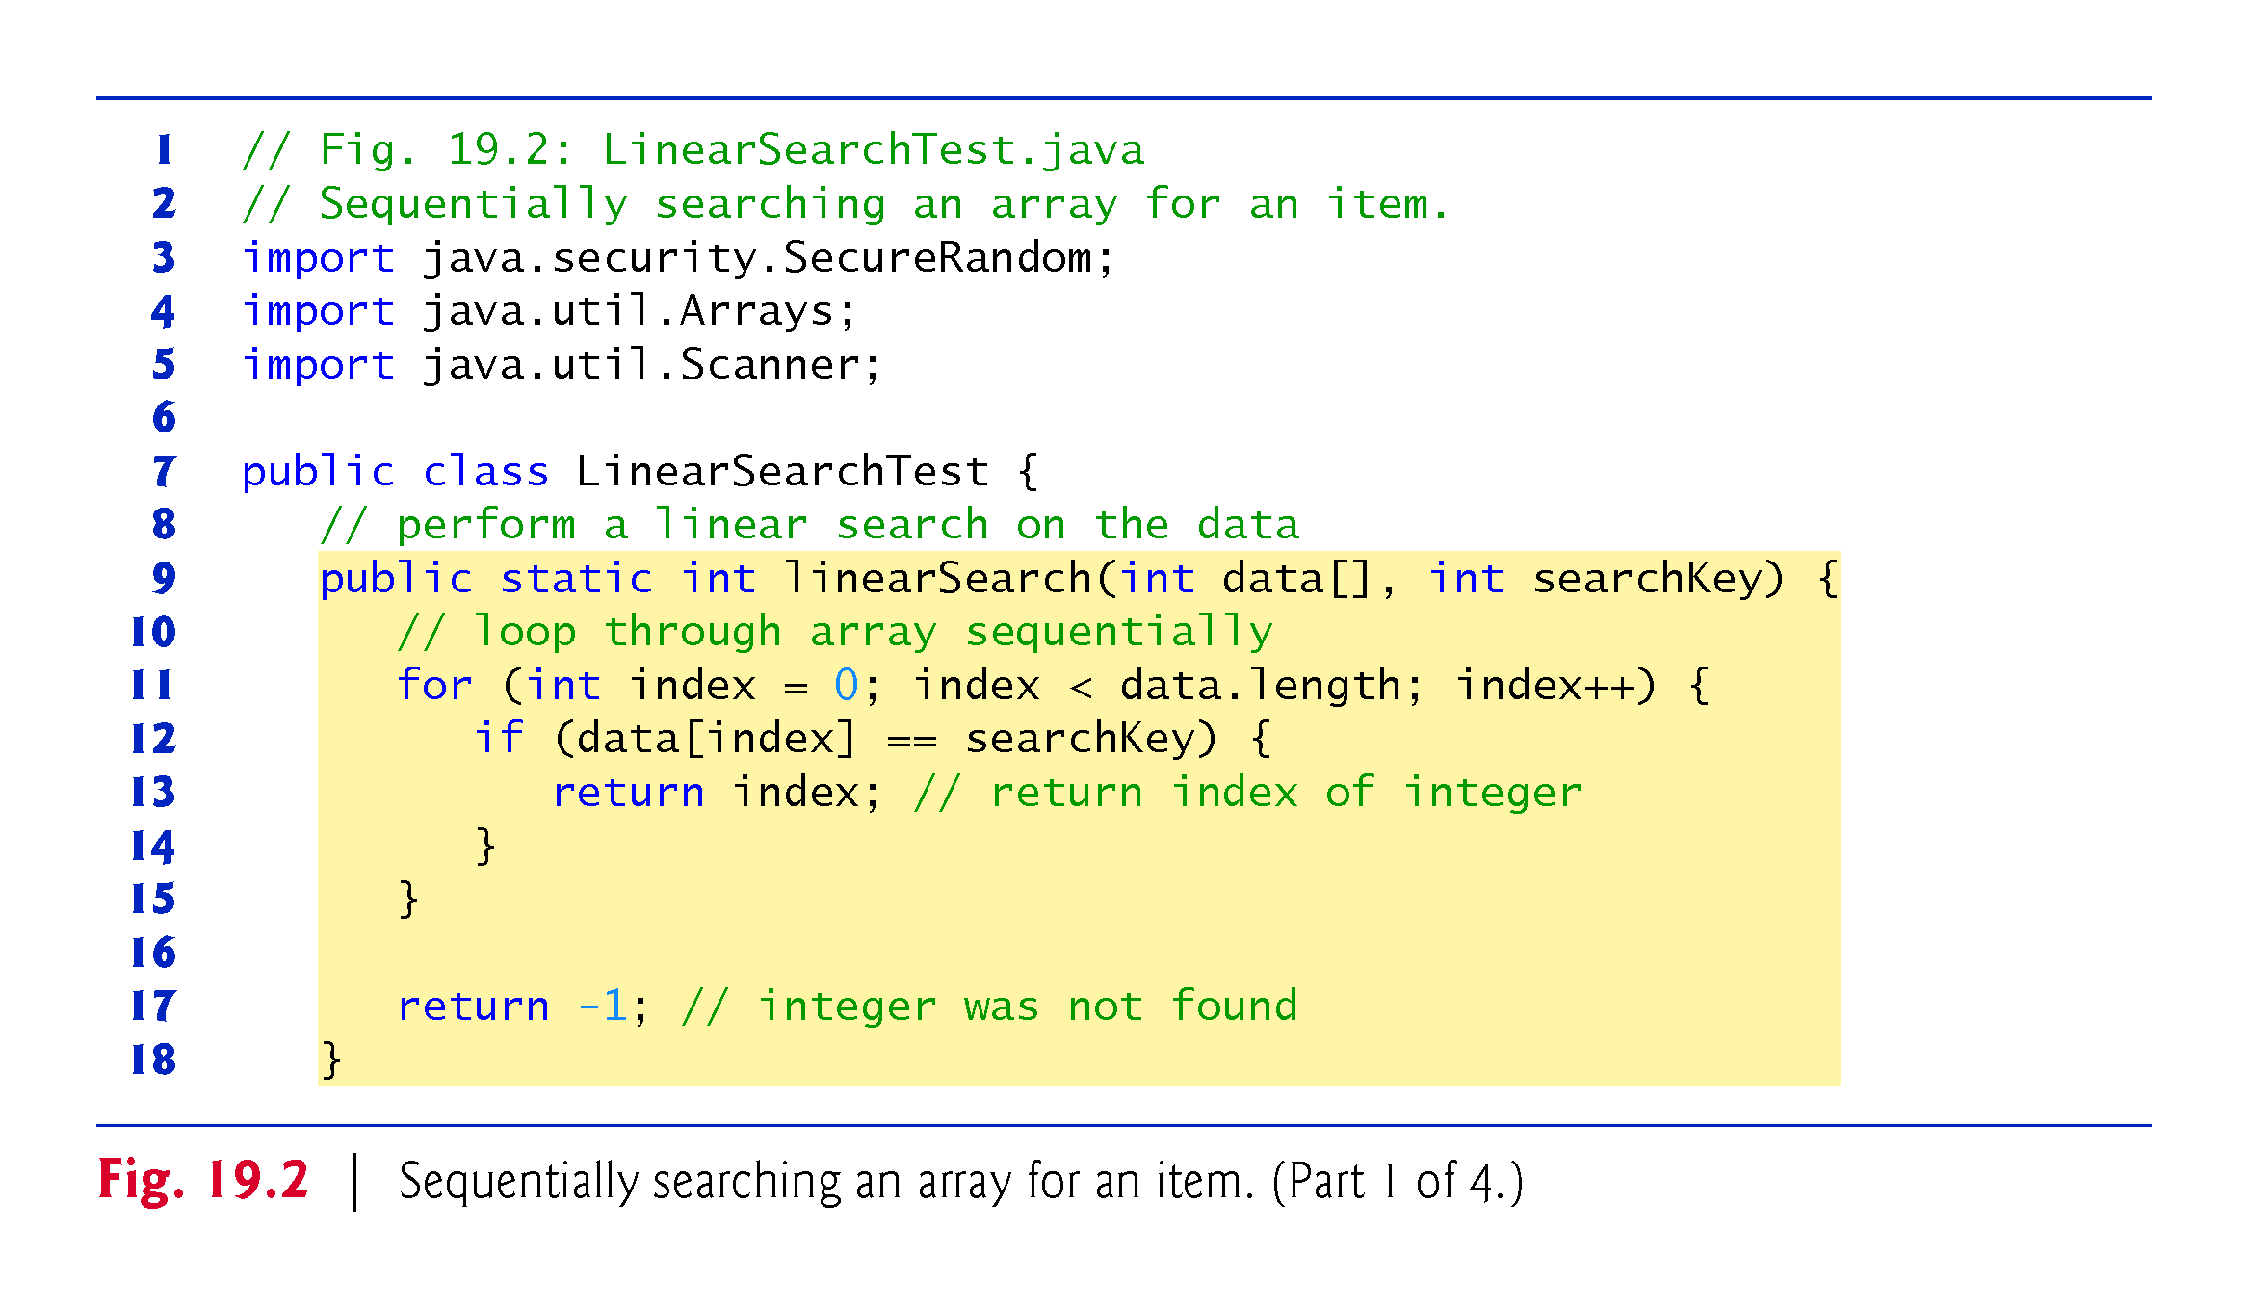

Slide 7
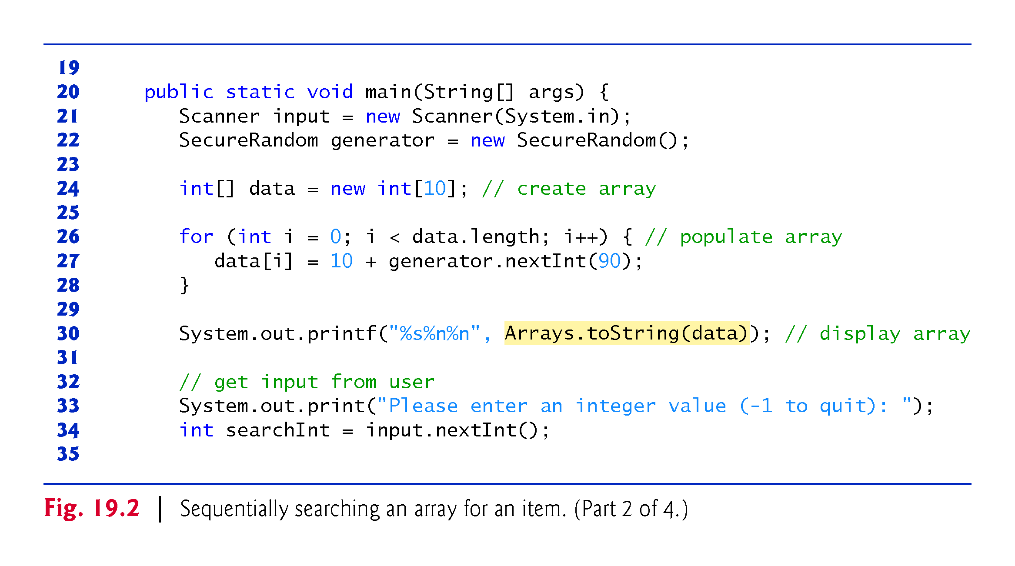

Slide 8
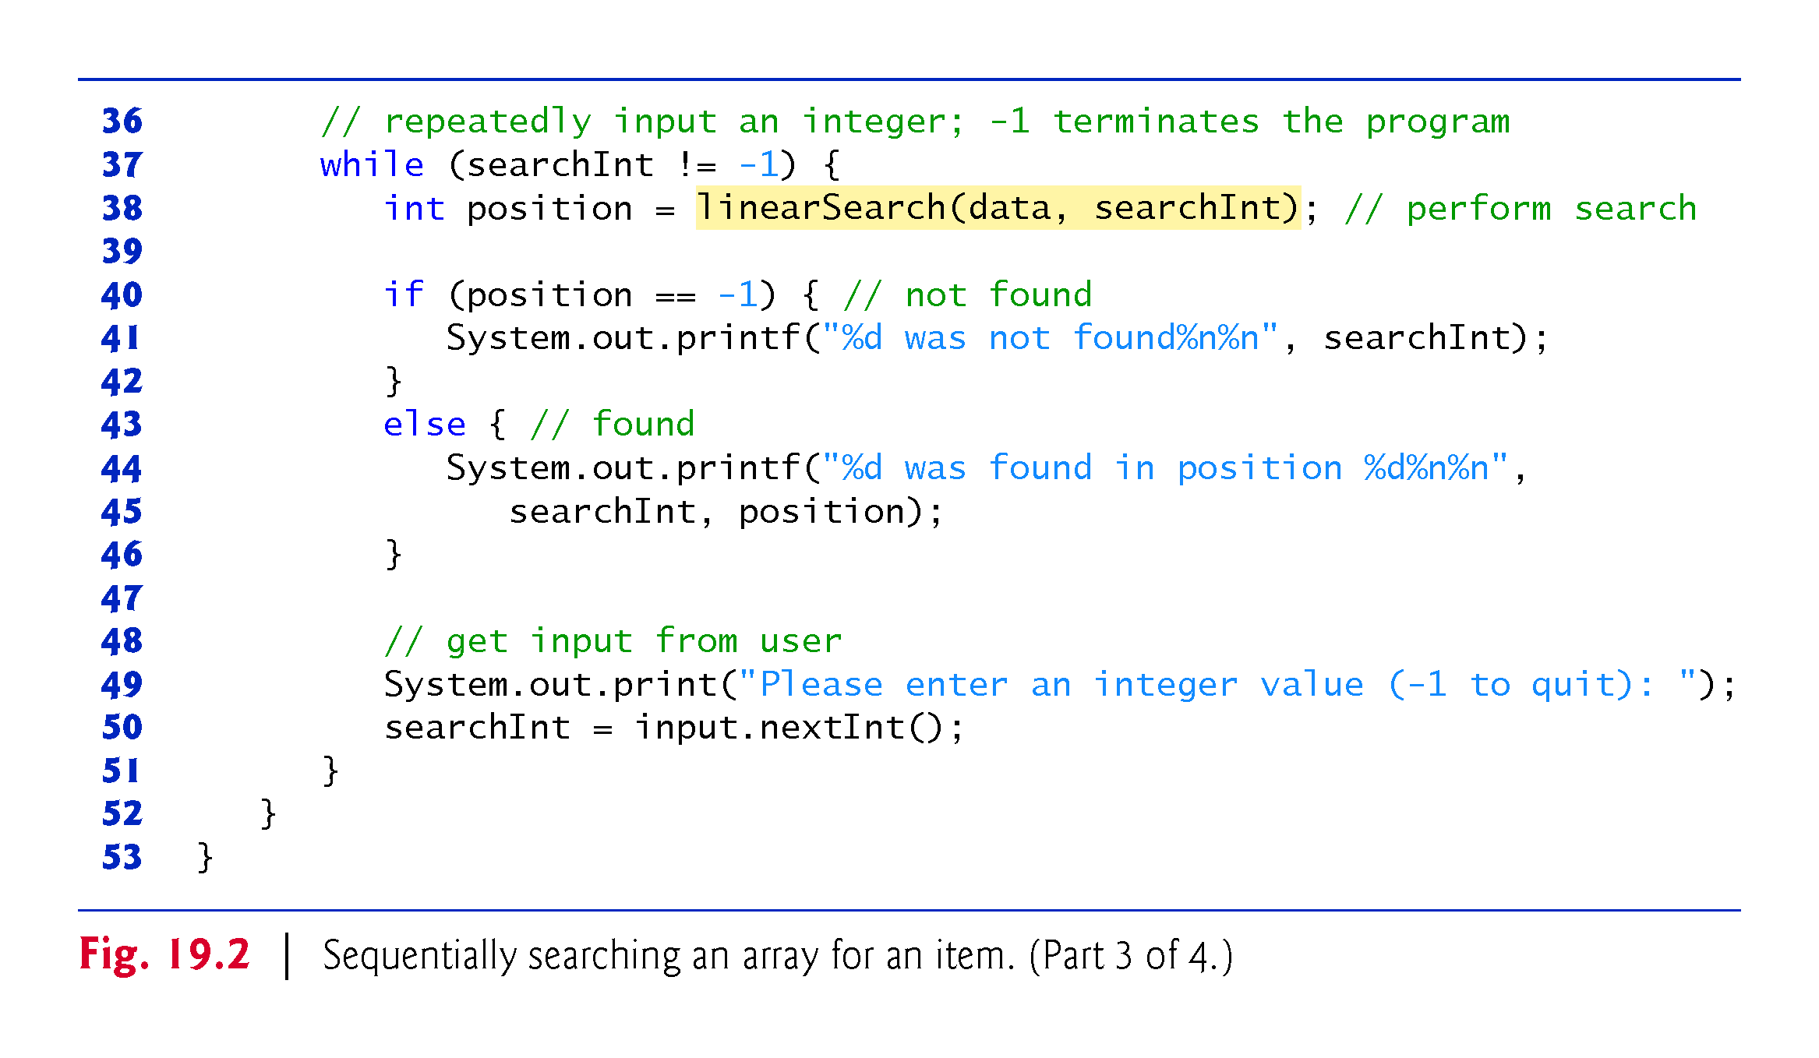

Slide 9
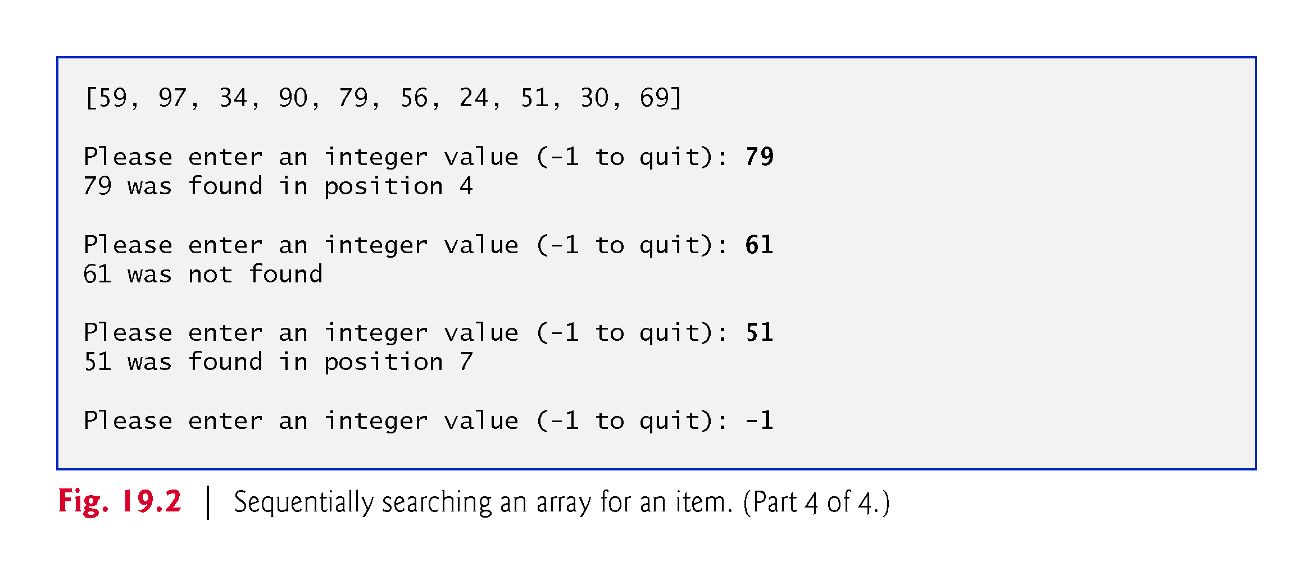

Slide 10
19.3 Big O Notation
Searching algorithms all accomplish the same goal—finding an element that matches a given search key, if such an element does, in fact, exist.
The major difference is the amount of effort they require to complete the search.
Big O notation indicates how hard an algorithm may have to work to solve a problem.
For searching and sorting algorithms, this depends particularly on how many data elements there are.

Slide 11
19.3.1 O(1) Algorithms
If an algorithm is completely independent of the number of elements in the array, it is said to have a constant run time, which is represented in Big O notation as O(1) and pronounced as “order one.”
An algorithm that’s O(1) does not necessarily require only one comparison.
O(1) just means that the number of comparisons is constant—it does not grow as the size of the array increases.

Slide 12
19.3.2 O(n) Algorithms
An algorithm that requires a total of n – 1 comparisons is said to be O(n).
An O(n) algorithm is referred to as having a linear run time.
O(n) is often pronounced “on the order of n” or simply “order n.”

Slide 13
19.3.3 O(n²) Algorithms
Constant factors are omitted in Big O notation.
Big O is concerned with how an algorithm’s run time grows in relation to the number of items processed.
O(n²) is referred to as quadratic run time and pronounced “on the order of n-squared” or more simply “order n-squared.”
When n is small, O(n²) algorithms (running on today’s computers) will not noticeably affect performance.
But as n grows, you’ll start to notice the performance degradation.
An O(n²) algorithm running on a million-element array would require a trillion “operations” (where each could actually require several machine instructions to execute).
A billion-element array would require a quintillion operations.
You’ll also see algorithms with more favorable Big O measures.

Slide 14
19.3.4 Big O of the Linear Search
The linear search algorithm runs in O(n) time.
The worst case in this algorithm is that every element must be checked to determine whether the search item exists in the array.
If the size of the array is doubled, the number of comparisons that the algorithm must perform is also doubled.
Linear search can provide outstanding performance if the element matching the search key happens to be at or near the front of the array.
We seek algorithms that perform well, on average, across all searches, including those where the element matching the search key is near the end of the array.
If a program needs to perform many searches on large arrays, it’s better to implement a more efficient algorithm, such as the binary search.

Slide 15
19.4 Binary Search
The binary search algorithm is more efficient than linear search, but it requires that the array be sorted.
The first iteration tests the middle element in the array. If this matches the search key, the algorithm ends.
If the search key is less than the middle element, the algorithm continues with only the first half of the array.
If the search key is greater than the middle element, the algorithm continues with only the second half.
Each iteration tests the middle value of the remaining portion of the array.
If the search key does not match the element, the algorithm eliminates half of the remaining elements.
The algorithm ends by either finding an element that matches the search key or reducing the subarray to zero size.

Slide 16
19.4.1 Binary Search Implementation
Class BinarySearchTest (Fig. 19.3) contains
static method binarySearch for performing searches of an int array for a specific key
static method remainingElements to display the remaining elements in the array being searched
main for testing binarySearch.

Slide 17
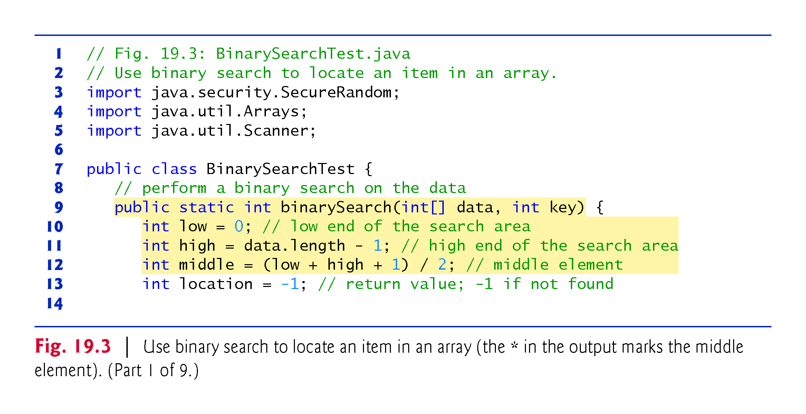

Slide 18
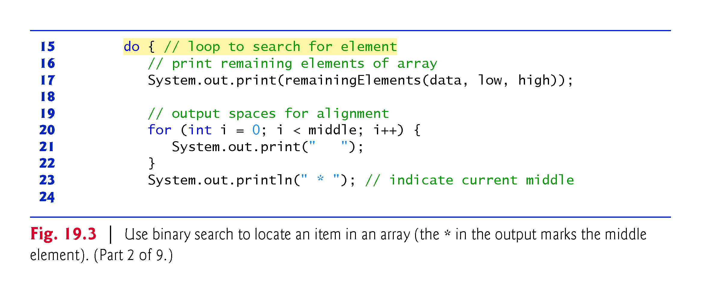

Slide 19
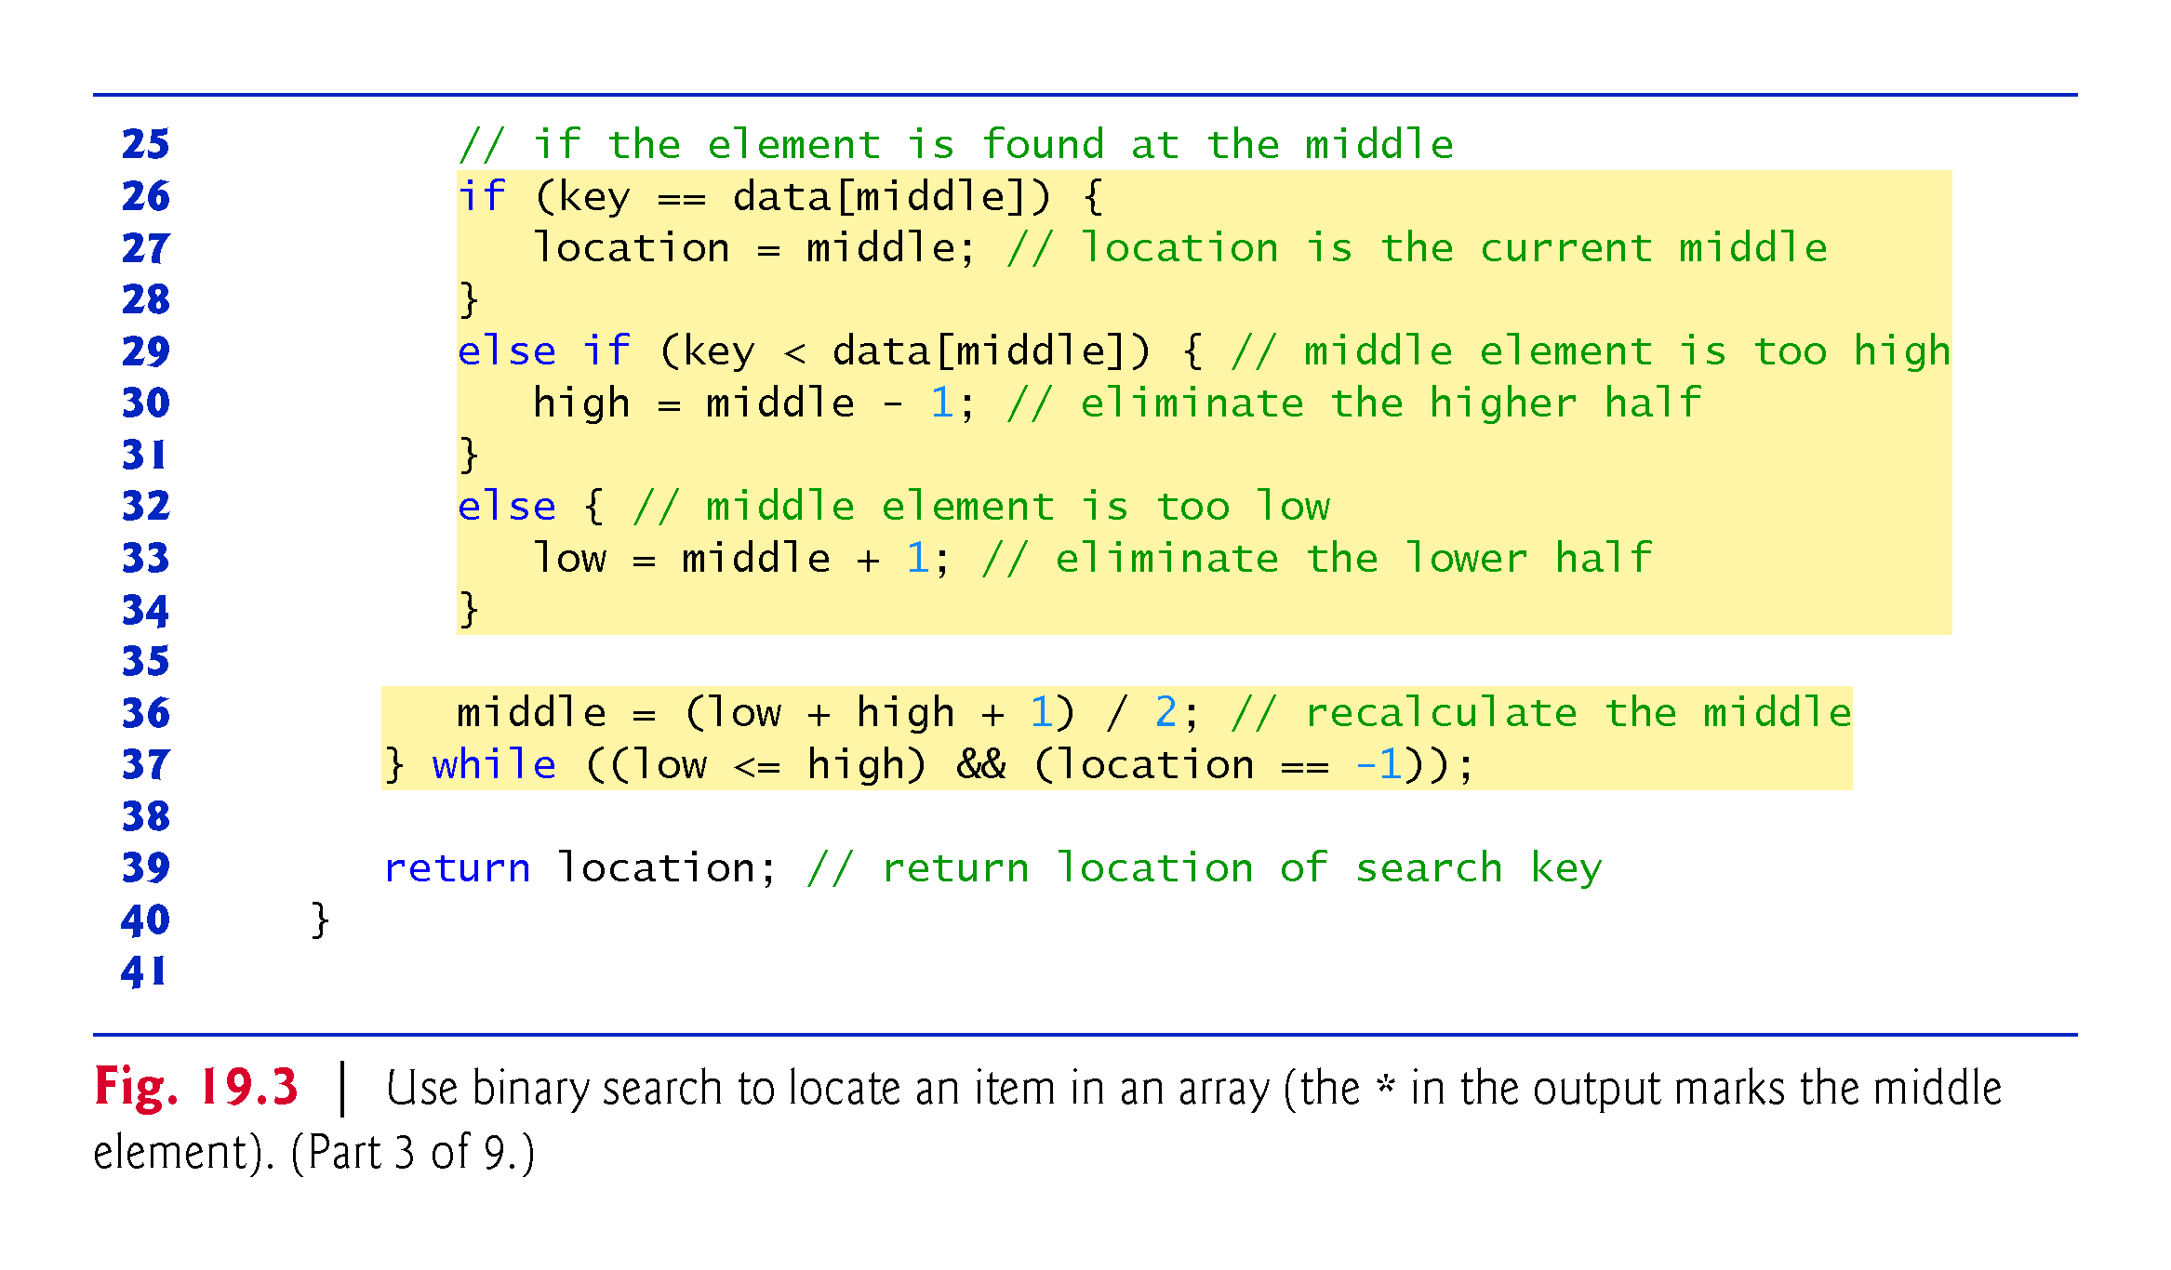

Slide 20
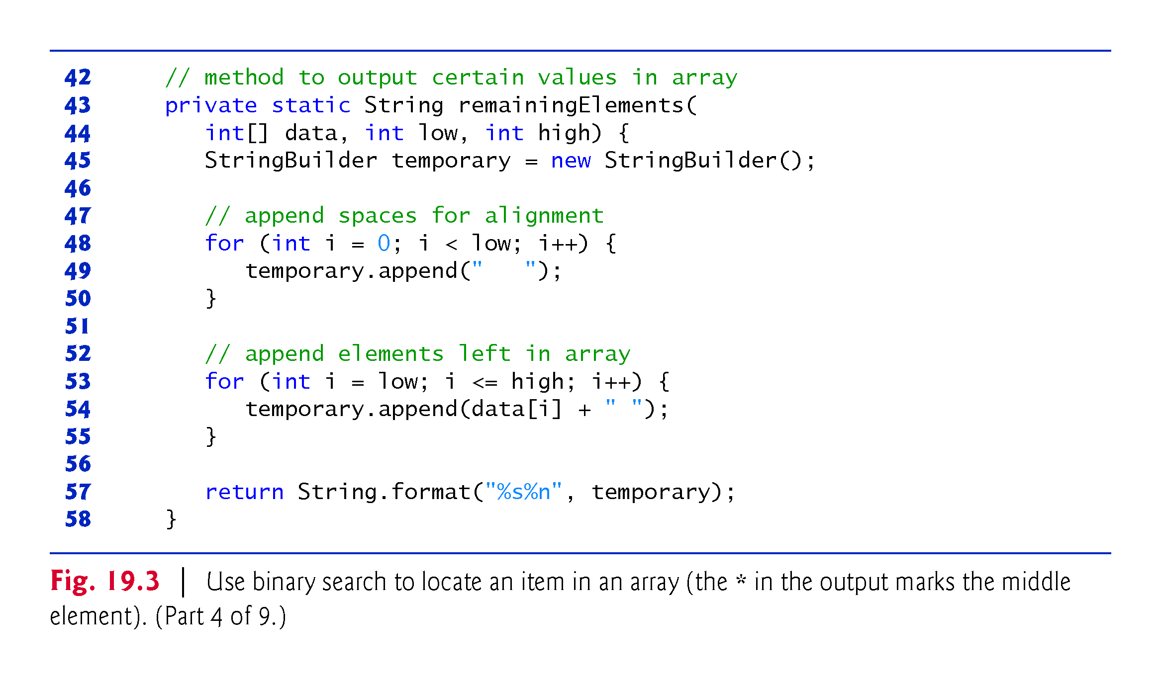

Slide 21
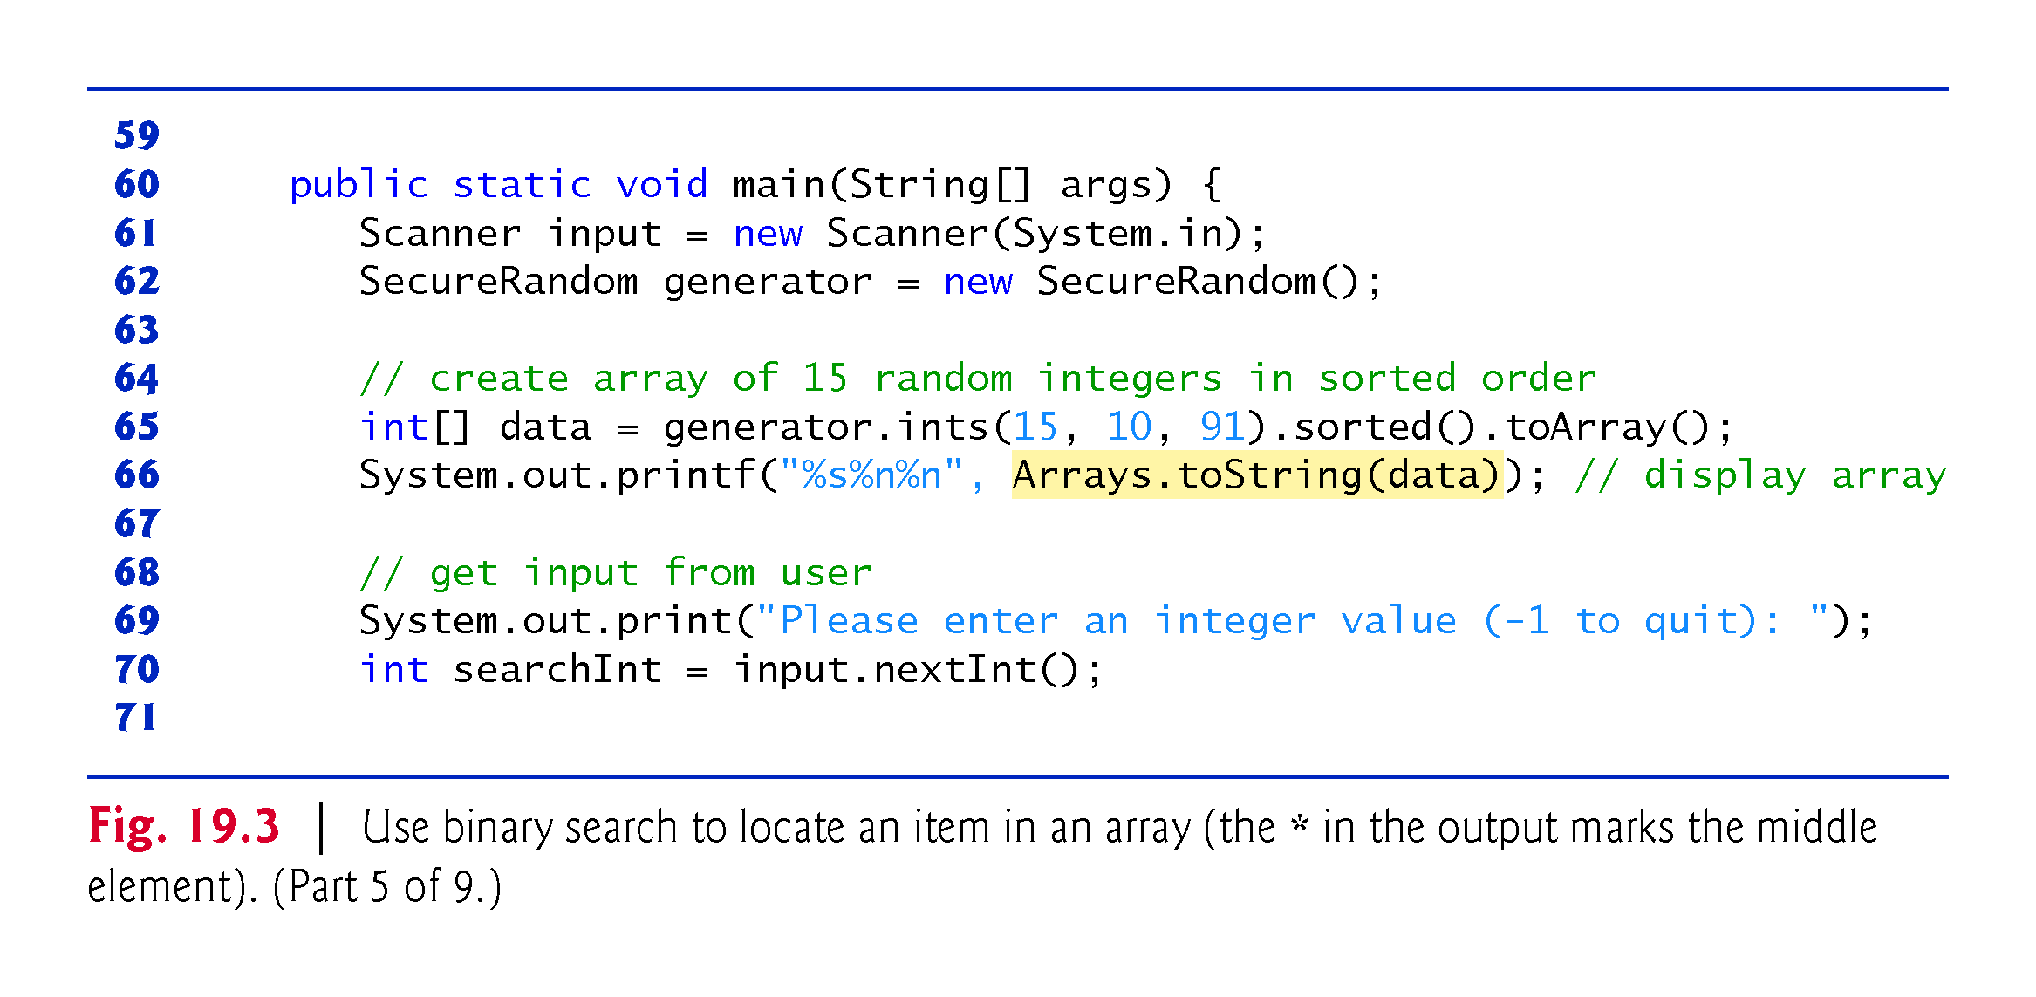

Slide 22
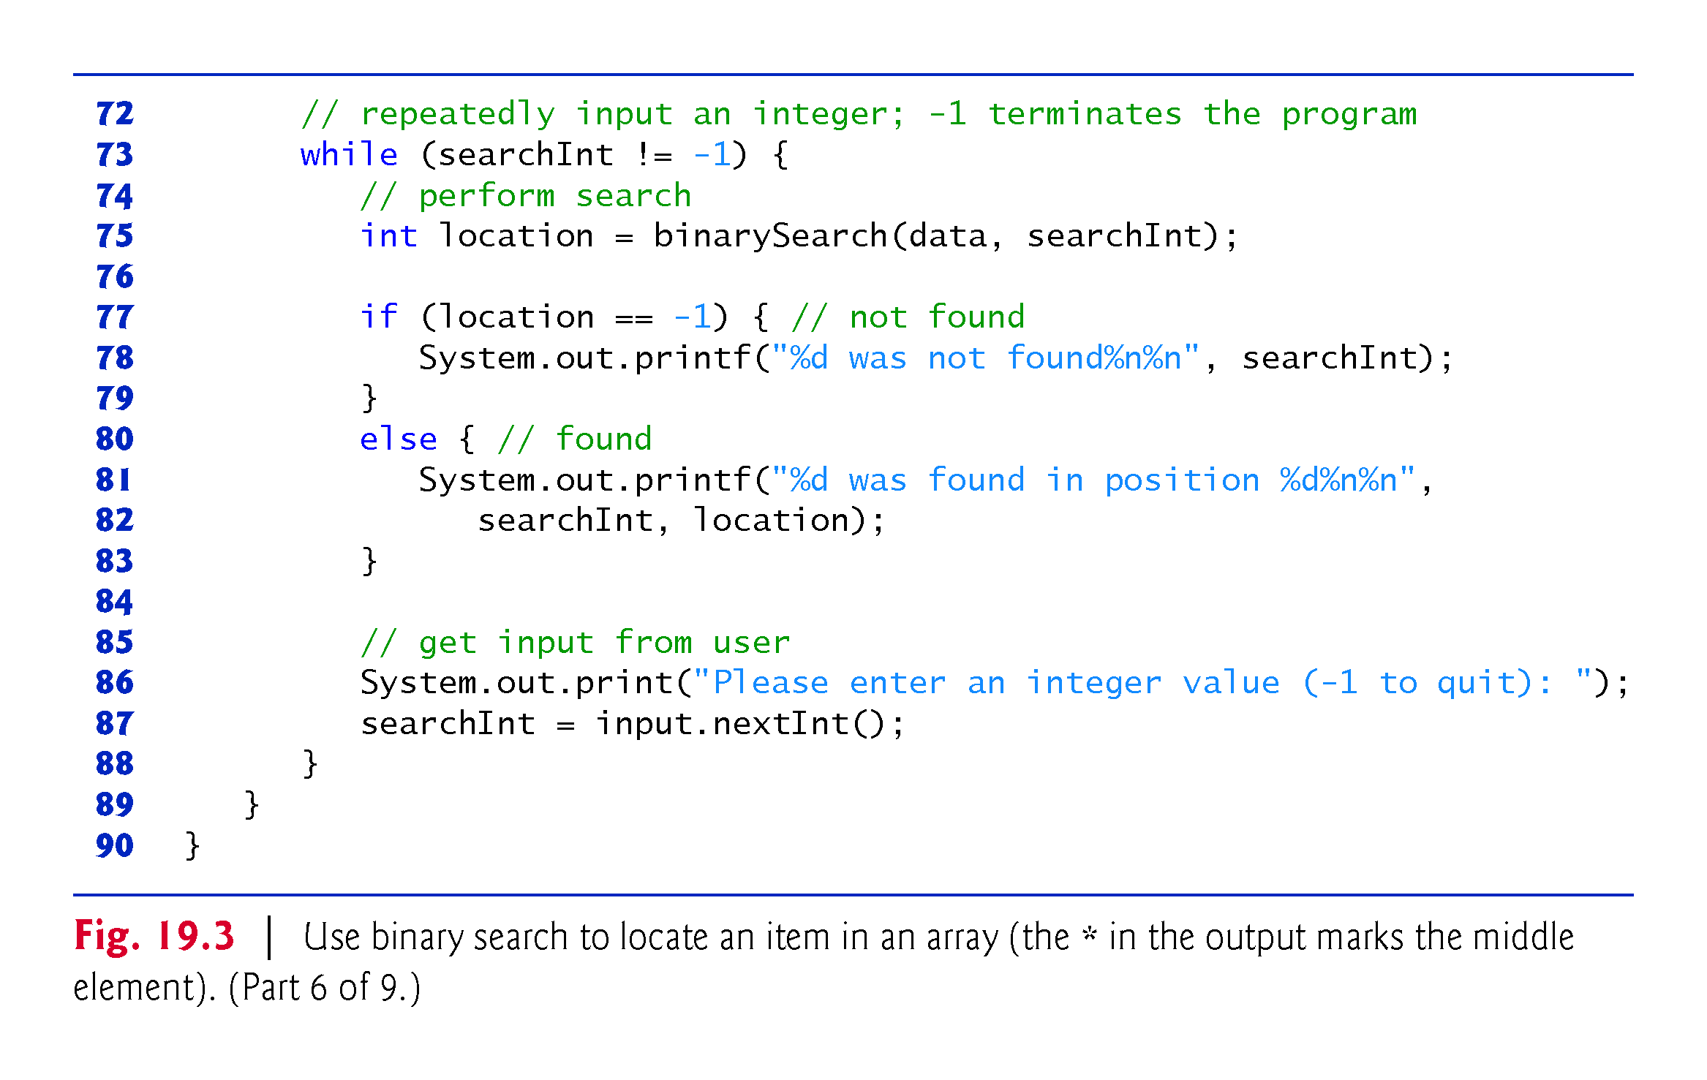

Slide 23
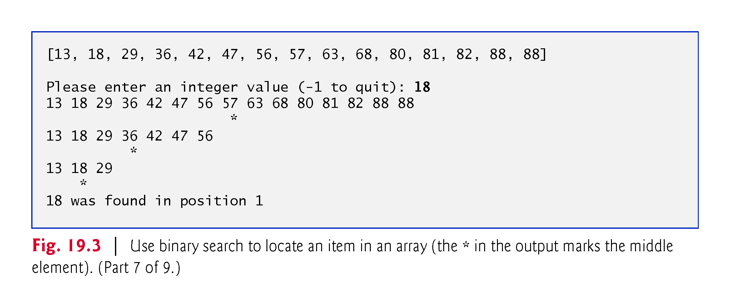

Slide 24
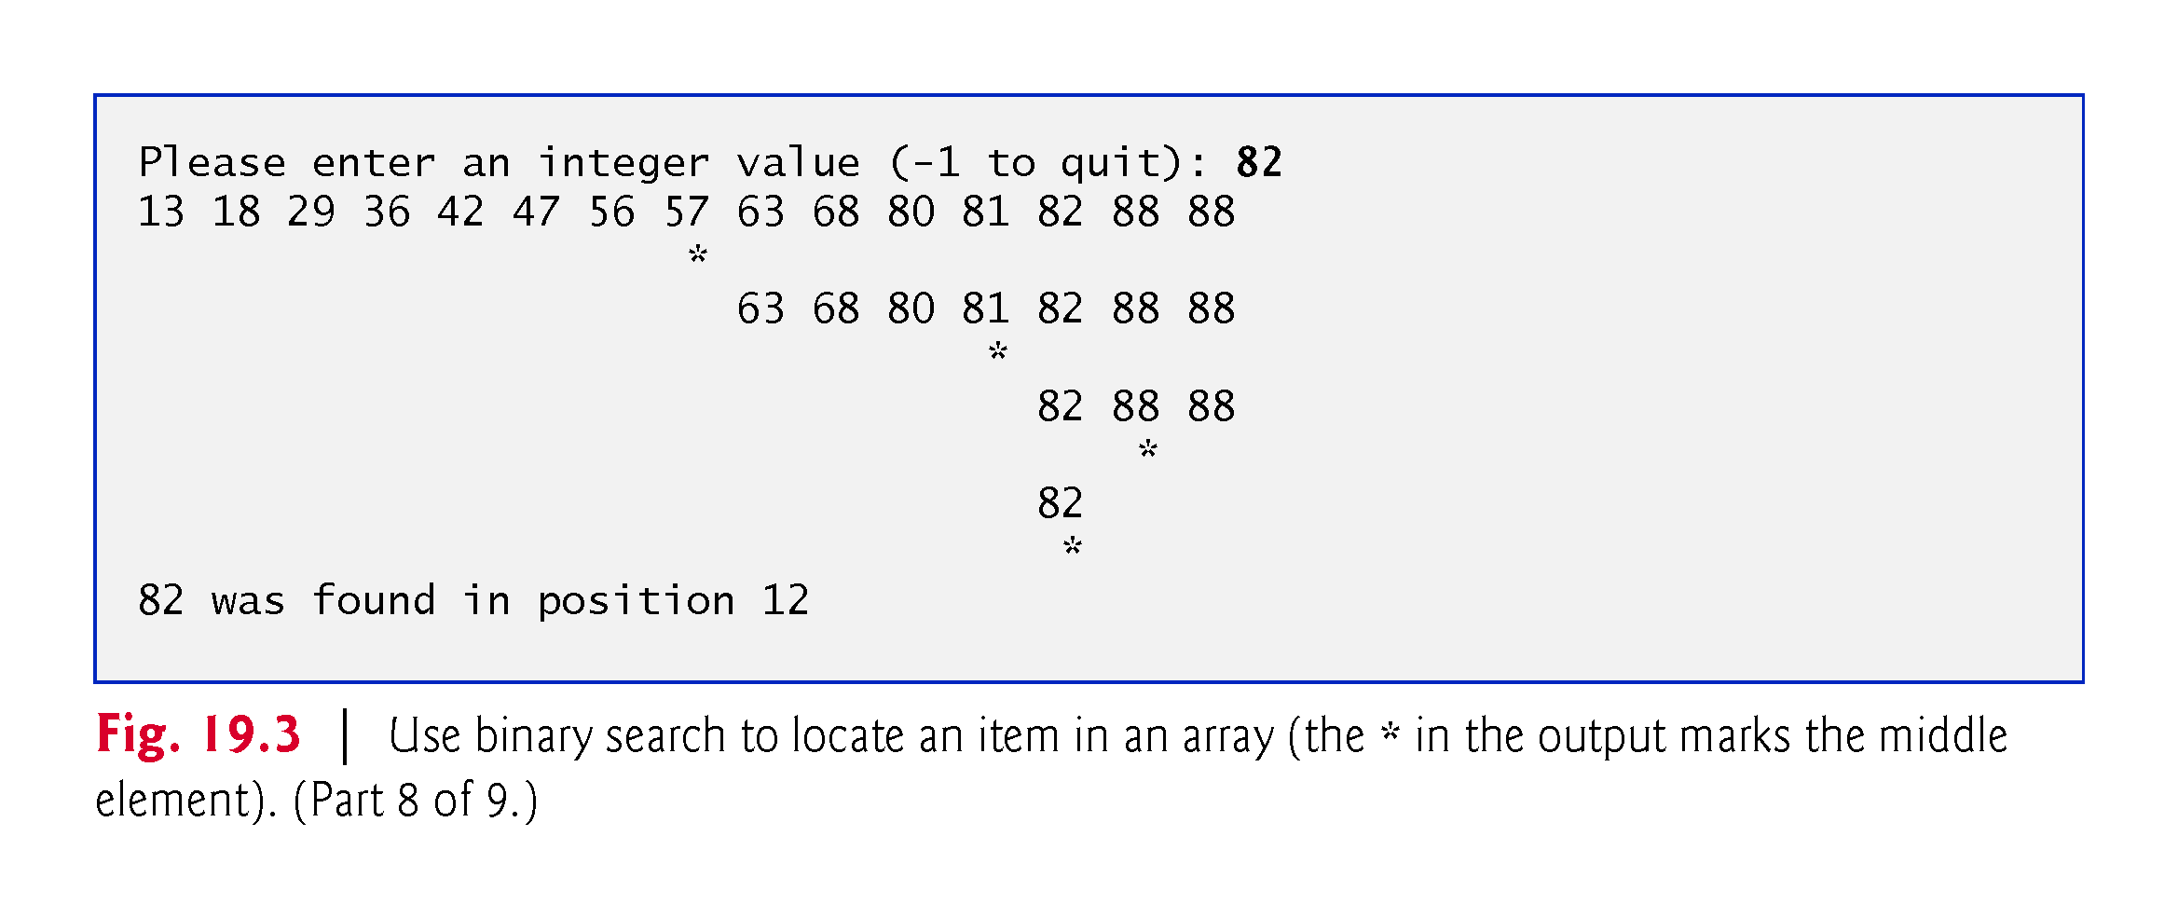

Slide 25
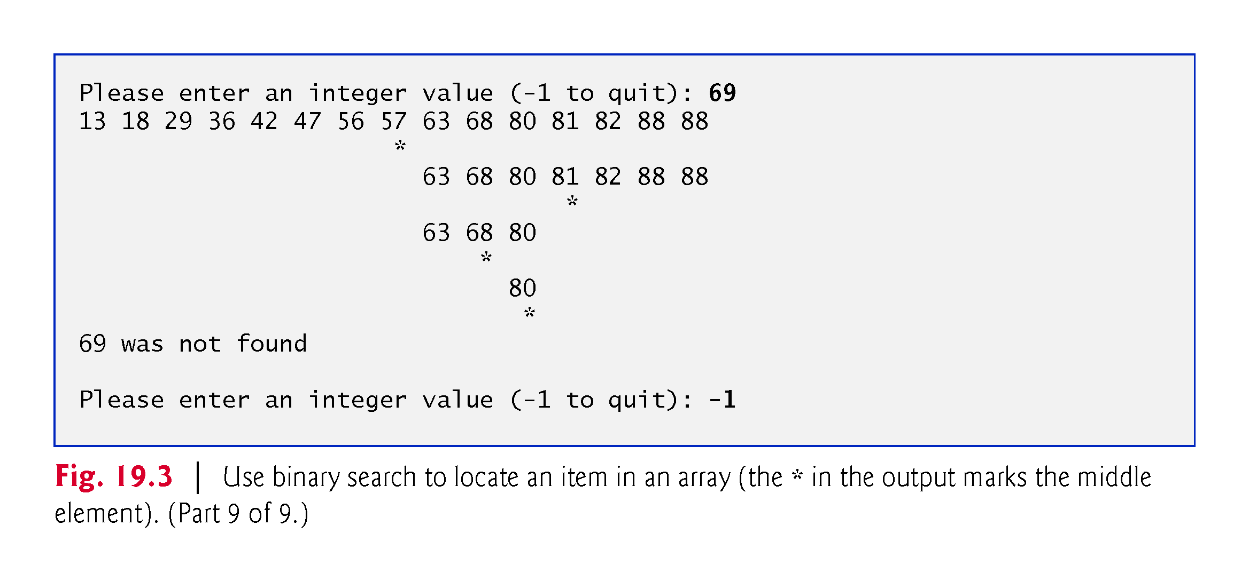

Slide 26
19.4.2 Efficiency of the Binary Search
In the worst-case scenario, searching a sorted array of 1023 elements takes only 10 comparisons when using a binary search.
The number 1023 (2¹⁰ – 1) is divided by 2 only 10 times to get the value 0, which indicates that there are no more elements to test.
Dividing by 2 is equivalent to one comparison in the binary search algorithm.
Thus, an array of 1,048,575 (2²⁰ – 1) elements takes a maximum of 20 comparisons to find the key, and an array of over one billion elements takes a maximum of 30 comparisons to find the key.
A difference between an average of 500 million comparisons for the linear search and a maximum of only 30 comparisons for the binary search!

Slide 27
19.4.2 Efficiency of the Binary Search (Cont.)
The maximum number of comparisons needed for the binary search of any sorted array is the exponent of the first power of 2 greater than the number of elements in the array, which is represented as log₂ n.
All logarithms grow at roughly the same rate, so in Big O notation the base can be omitted.
This results in a Big O of O(log n) for a binary search, which is also known as logarithmic run time and pronounced as “order log n.”

Slide 28
19.5 Sorting Algorithms
Sorting data (i.e., placing the data into some particular order, such as ascending or descending) is one of the most important computing applications.
An important item to understand about sorting is that the end result—the sorted array—will be the same no matter which algorithm you use to sort the array.
The choice of algorithm affects only the run time and memory use of the program.
The rest of this chapter introduces three common sorting algorithms.
The first two—selection sort and insertion sort—are easy to program but inefficient.
The last algorithm—merge sort—is much faster than selection sort and insertion sort but harder to program.

Slide 29
19.6 Selection Sort
Selection sort
simple, but inefficient, sorting algorithm
Its first iteration selects the smallest element in the array and swaps it with the first element.
The second iteration selects the second-smallest item (which is the smallest item of the remaining elements) and swaps it with the second element.
The algorithm continues until the last iteration selects the second-largest element and swaps it with the second-to-last index, leaving the largest element in the last index.
After the ith iteration, the smallest i items of the array will be sorted into increasing order in the first i elements of the array.
After the first iteration, the smallest element is in the first position. After the second iteration, the two smallest elements are in order in the first two positions, etc.

Slide 30
19.6.1 Selection Sort Implementation
Class SelectionSortTest (Fig. 19.4) contains:
static method selectionSort to sort an int array using the selection sort algorithm.
static method swap to swap the values of two array elements.
static method printPass to display the array contents after each pass.
main to test method selectionSort.

Slide 31
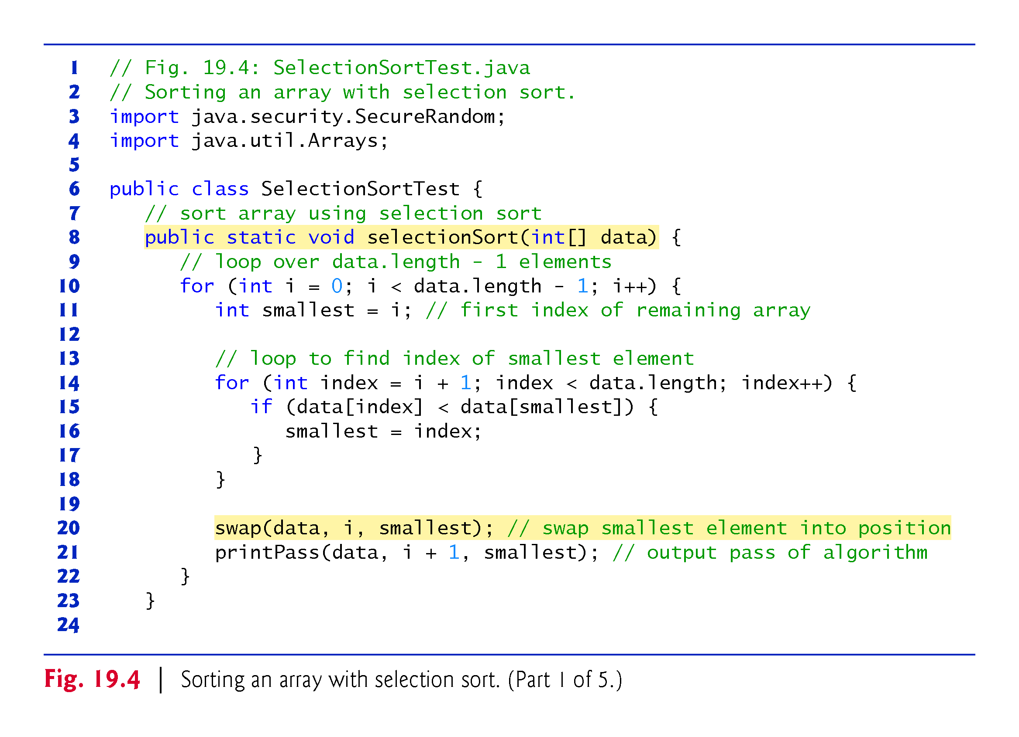

Slide 32
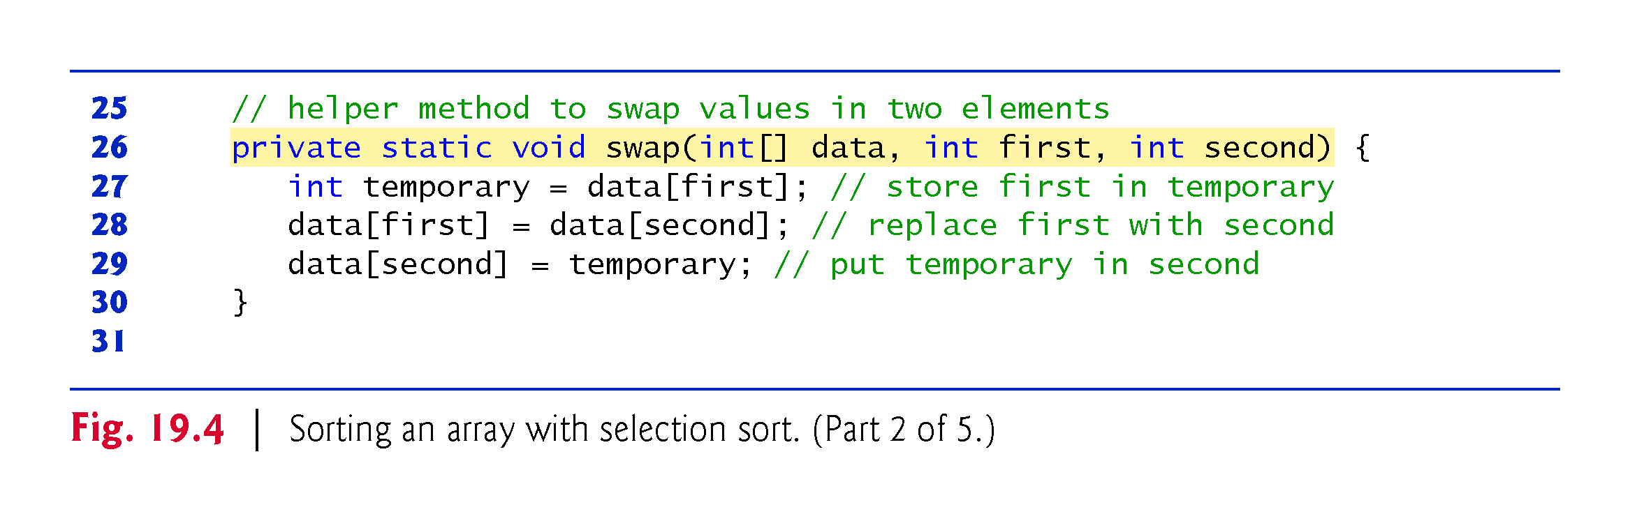

Slide 33
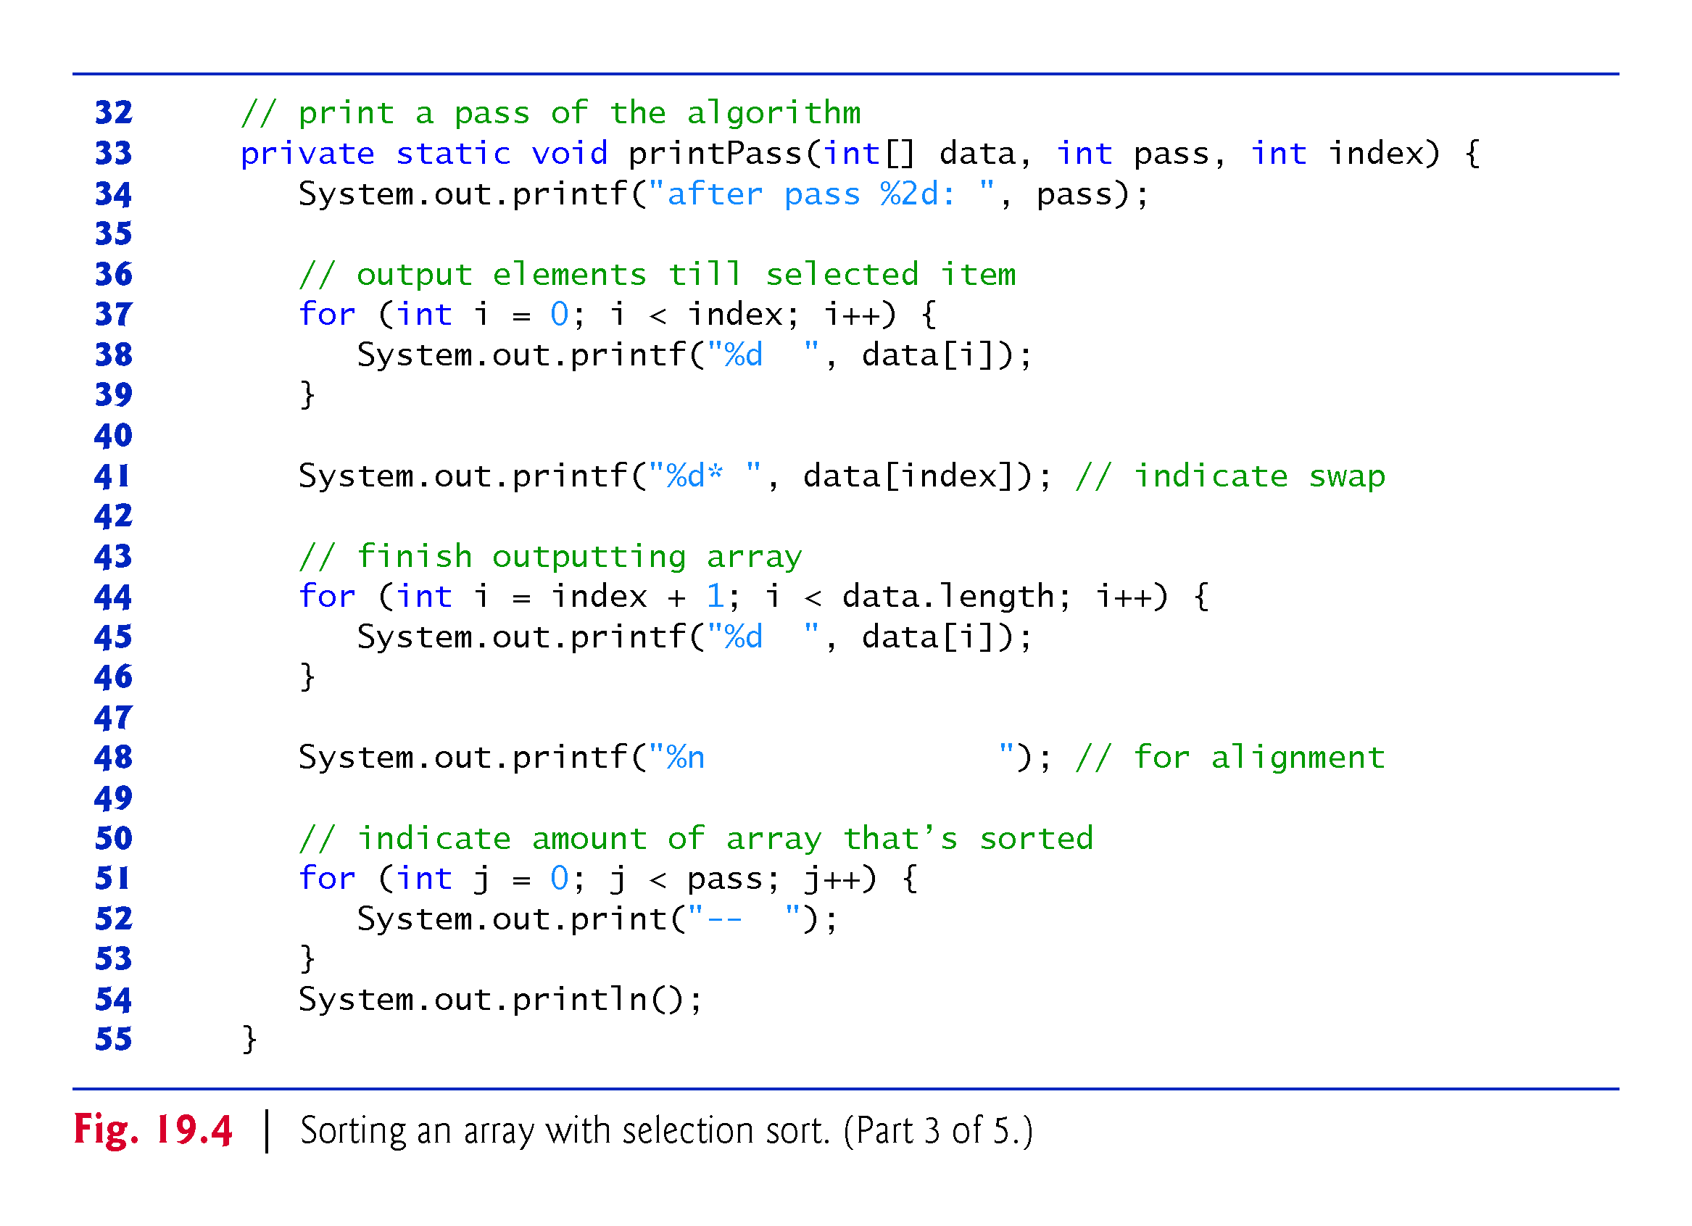

Slide 34
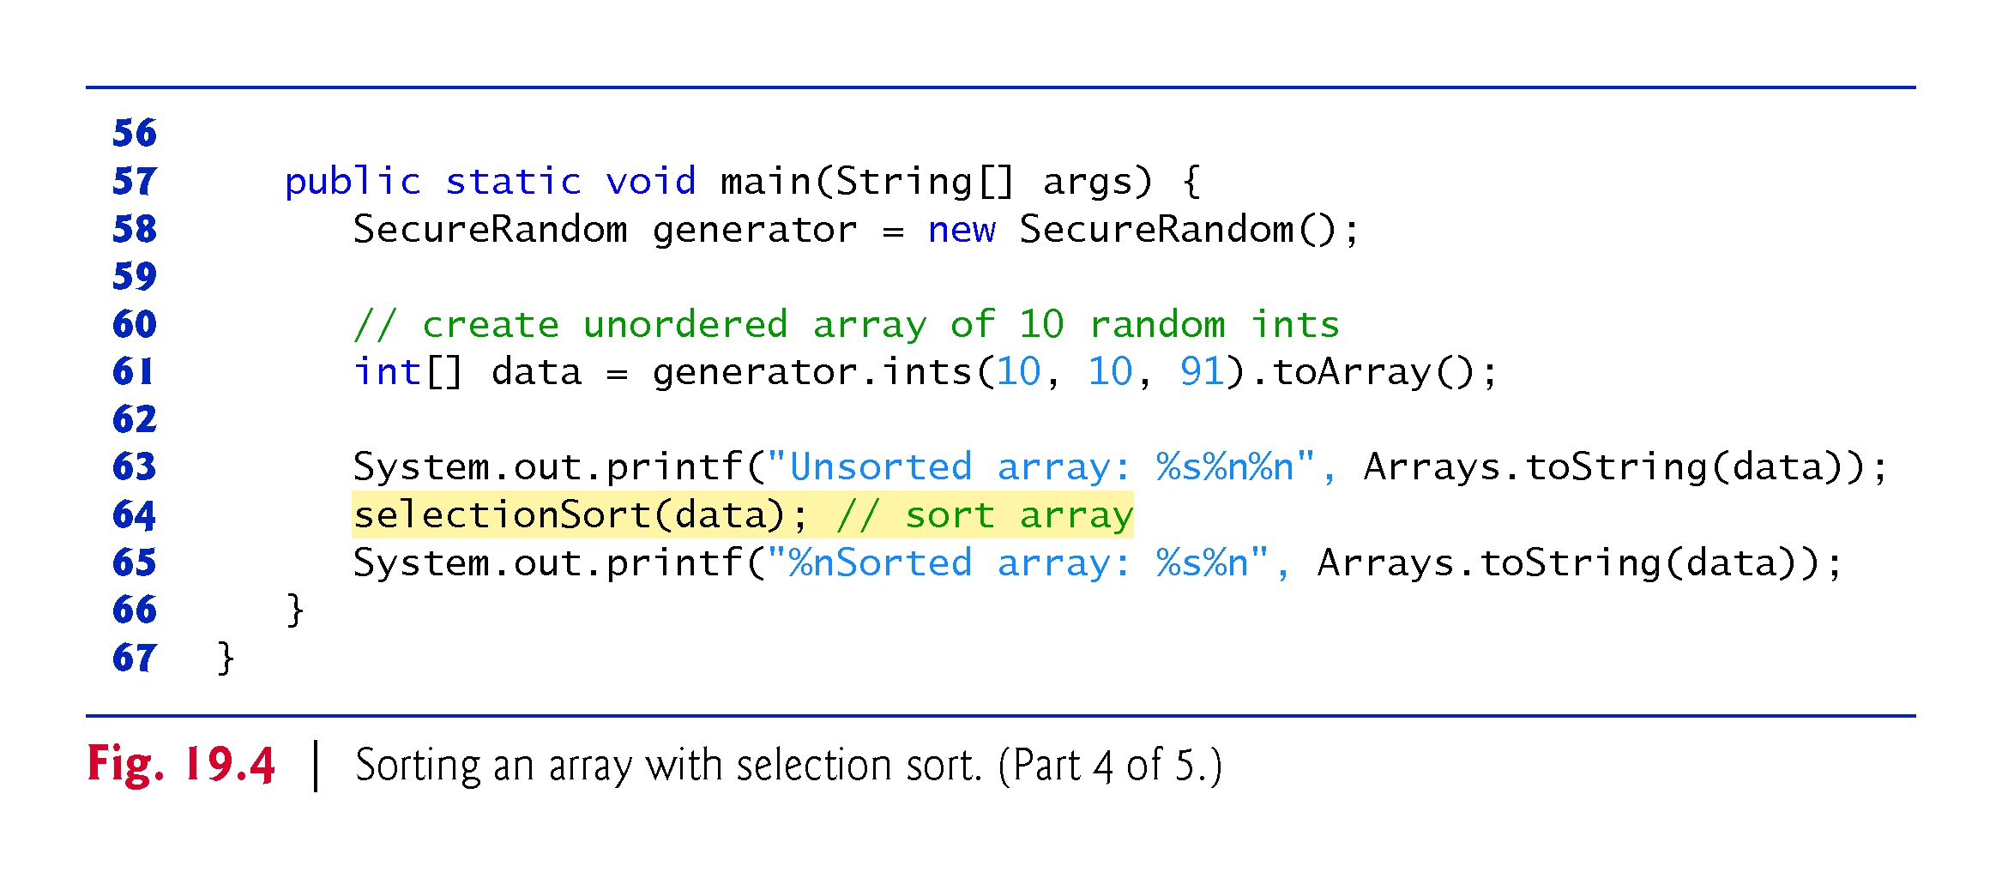

Slide 35
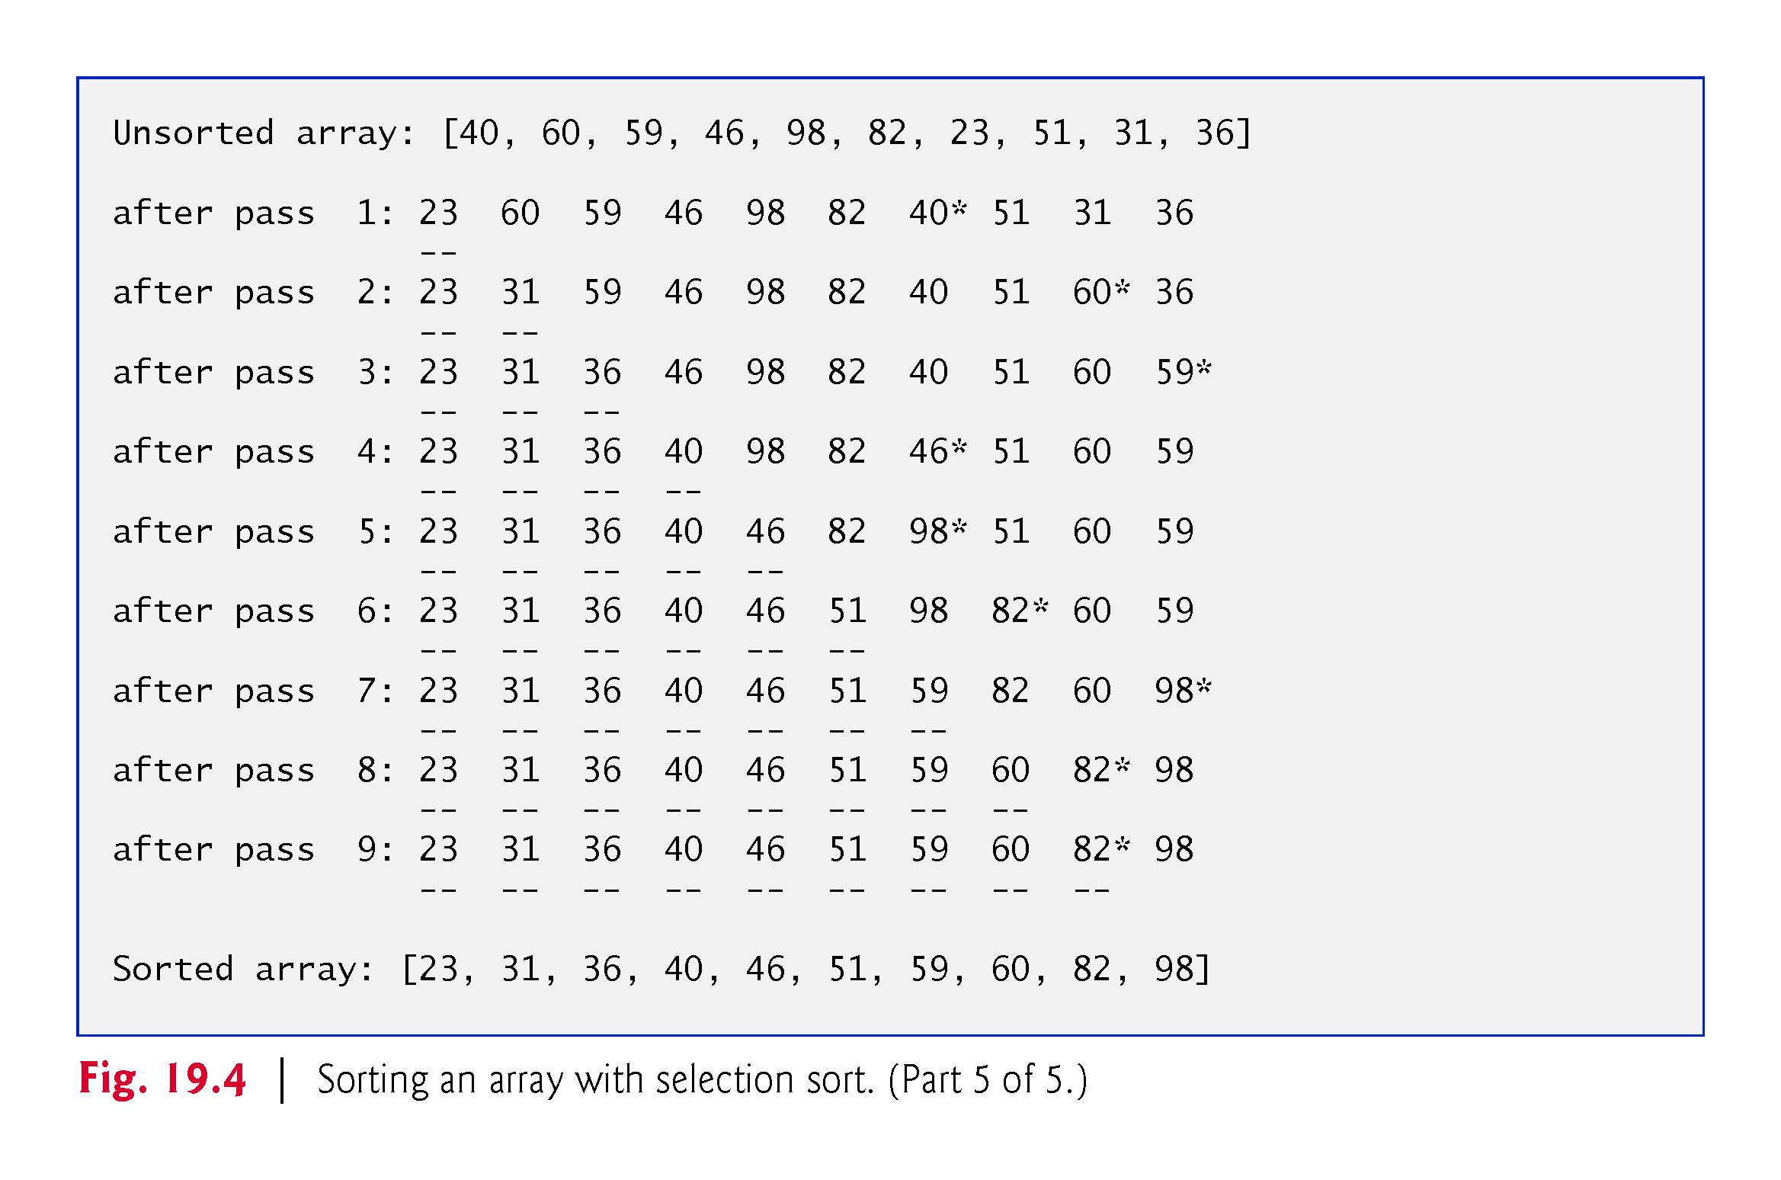

Slide 36
19.6.2 Efficiency of the Selection Sort
The selection sort algorithm runs in O(n²) time.
method selectionSort uses nested for loops:
The outer loop iterates over the first n – 1 elements, swapping the smallest remaining element into its sorted position.
The inner loop iterates over each item in the remaining array, searching for the smallest element.
This loop executes n – 1 times during the first iteration of the outer loop, n – 2 times during the second, then n - 3, …, 3, 2, 1.
This loop will iterate a total of n(n - 1) / 2 or (n² - n)/2
In Big O notation, smaller terms drop out and constants are ignored, leaving a Big O of O(n²)

Slide 37
19.7 Insertion Sort
Insertion sort
another simple, but inefficient, sorting algorithm
The first iteration takes the second element in the array and, if it’s less than the first element, swaps it with the first element.
The second iteration looks at the third element and inserts it into the correct position with respect to the first two, so all three elements are in order.
At the ith iteration of this algorithm, the first i elements in the original array will be sorted.
The insertion sort algorithm also runs in O(n²) time.

Slide 38
19.7.1 Insertion Sort Implementation
Class InsertionSortTest (Fig. 19.5) contains:
static method insertionSort to sort an int array using the selection sort algorithm.
static method printPass to display the array contents after each pass.
main to test method selectionSort.

Slide 39
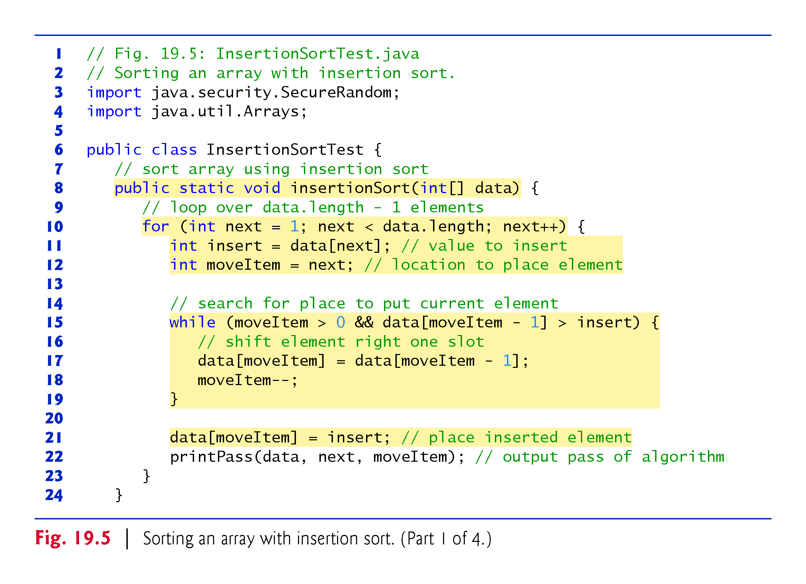

Slide 40
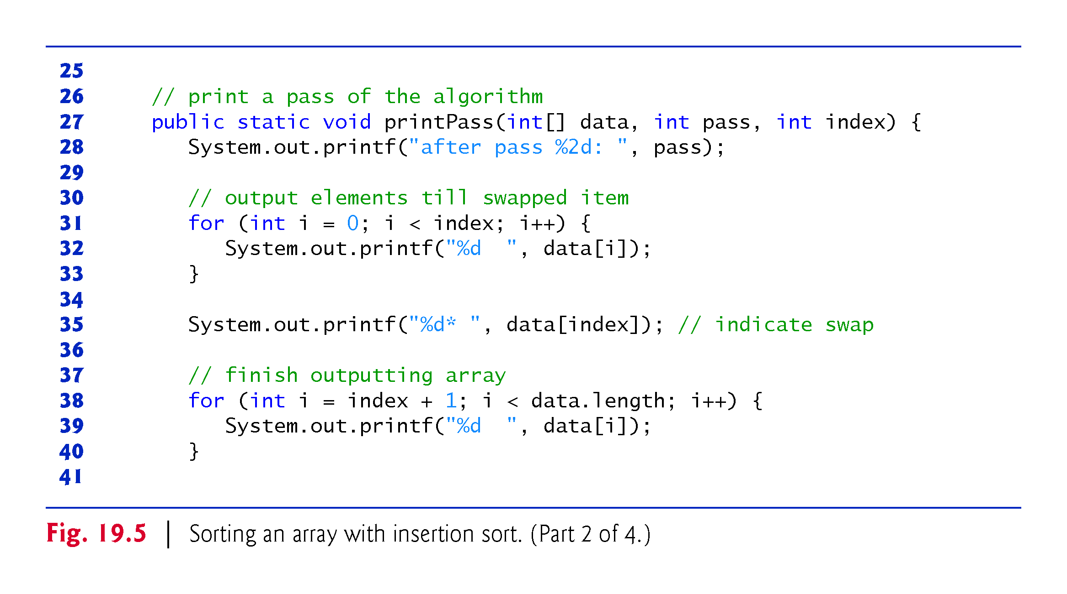

Slide 41
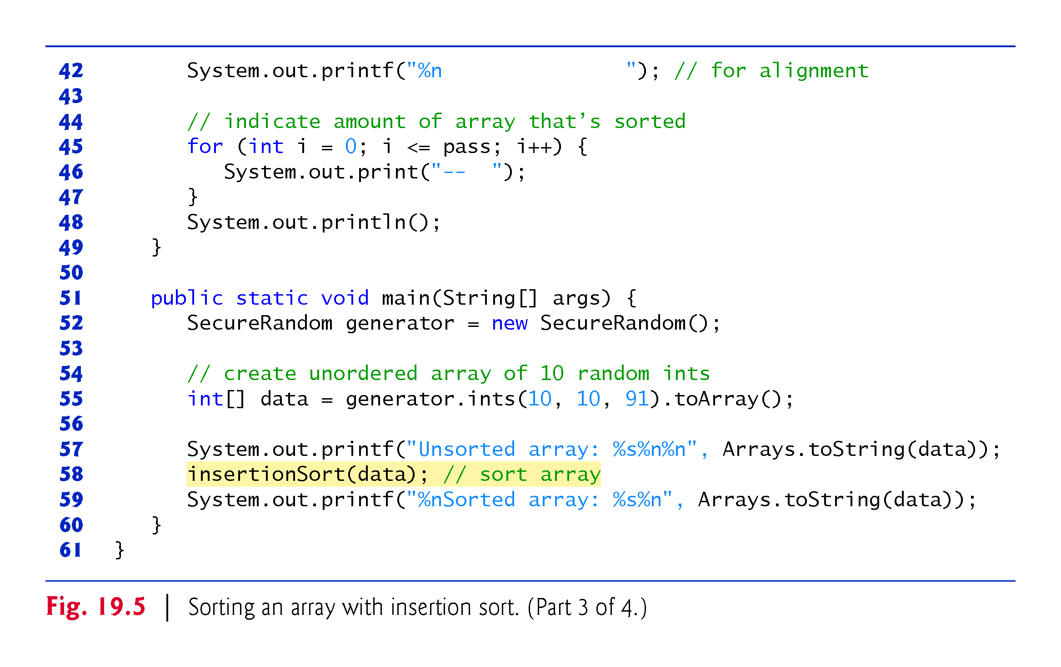

Slide 42
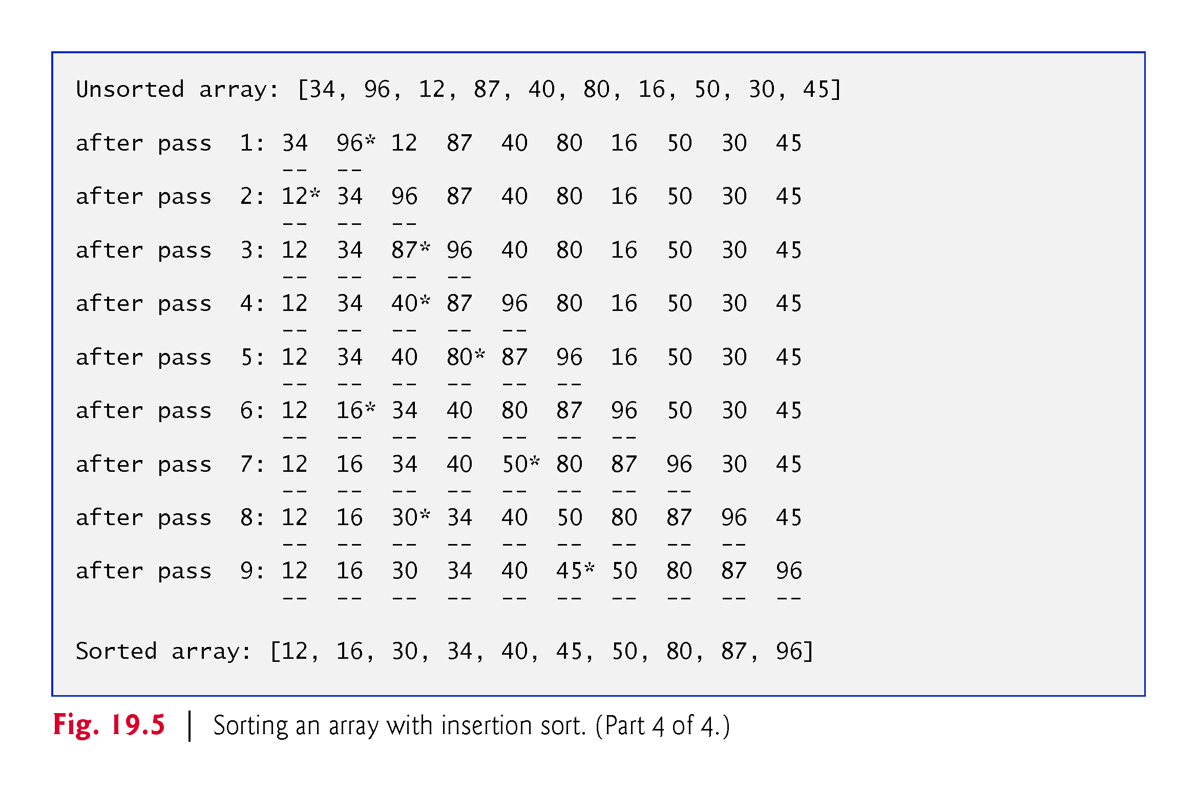

Slide 43
19.7.2 Efficiency of the Insertion Sort
The insertion sort algorithm runs in O(n²) time.
method selectionSort contains two loops:
The for loop iterates over the first n – 1 elements, inserting an element into the appropriate position in the elements sorted so far.
The while loop iterates over the preceding elements in the array.
In the worst case, the while loop will require n – 1 comparisons.
Each individual loop runs in O(n) times.
In Big O notation, nested loops mean you must multiply the number of comparisons.
For each O(n) iterations of the other loop, there will be O(n) iterations of the inner loop.
Multiplying these values results in a Big O of O(n²)

Slide 44
19.8 Merge Sort
Merge sort
efficient sorting algorithm
conceptually more complex than selection sort and insertion sort
Sorts an array by splitting it into two equal-sized subarrays, sorting each subarray, then merging them into one larger array.
The implementation of merge sort in this example is recursive.
The base case is an array with one element, which is, of course, sorted, so the merge sort immediately returns in this case.
The recursion step splits the array into two approximately equal pieces, recursively sorts them, then merges the two sorted arrays into one larger, sorted array.
Merge sort has an efficiency of O(n log n).

Slide 45
19.8.1 Merge Sort Implementation
Class MergeSortTest (Fig. 19.6) contains:
static method mergeSort to initiate the sorting of an int array using the merge algorithm.
static method sortArry to perform the recursive merge sort algorithm–this is called by the mergeSort method.
static method merge to merge two sorted subarrays into a single sorted array.
static method subarrayString to get a subarrays’s String representation for output purposes.
main to test method mergeSort.

Slide 46
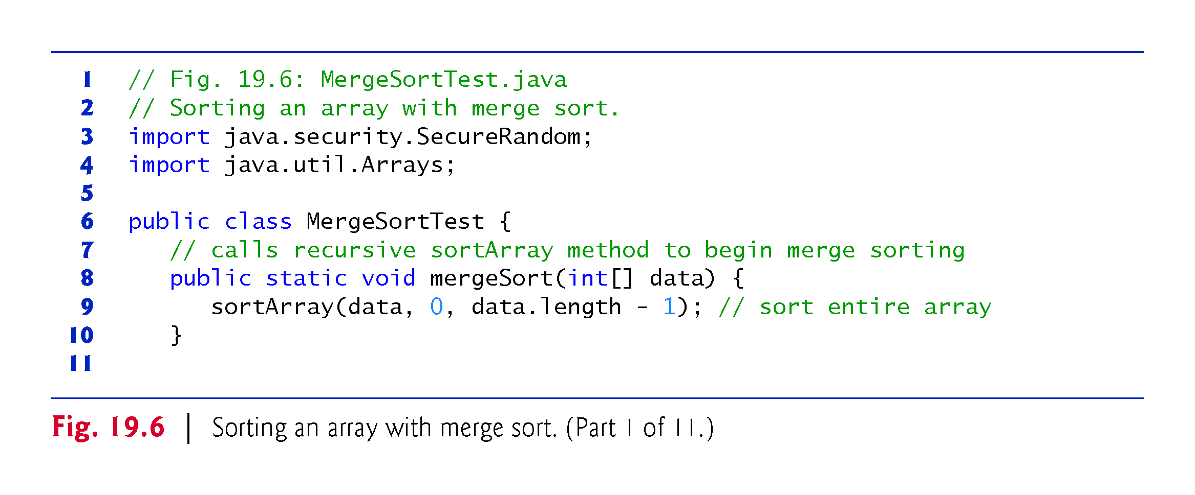

Slide 47
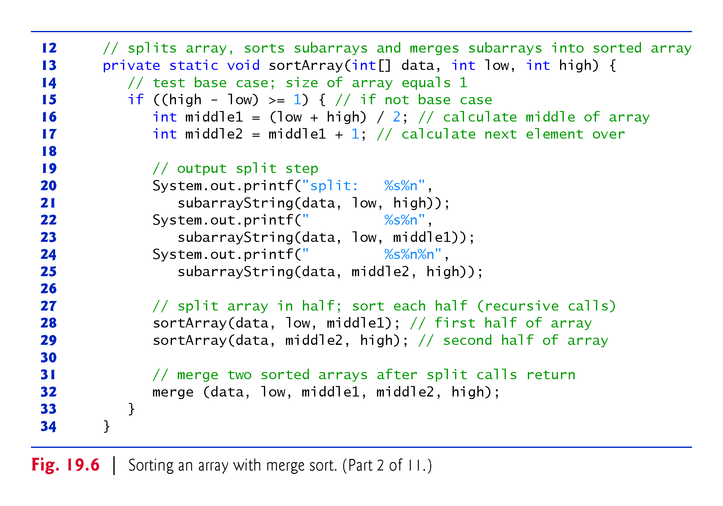

Slide 48
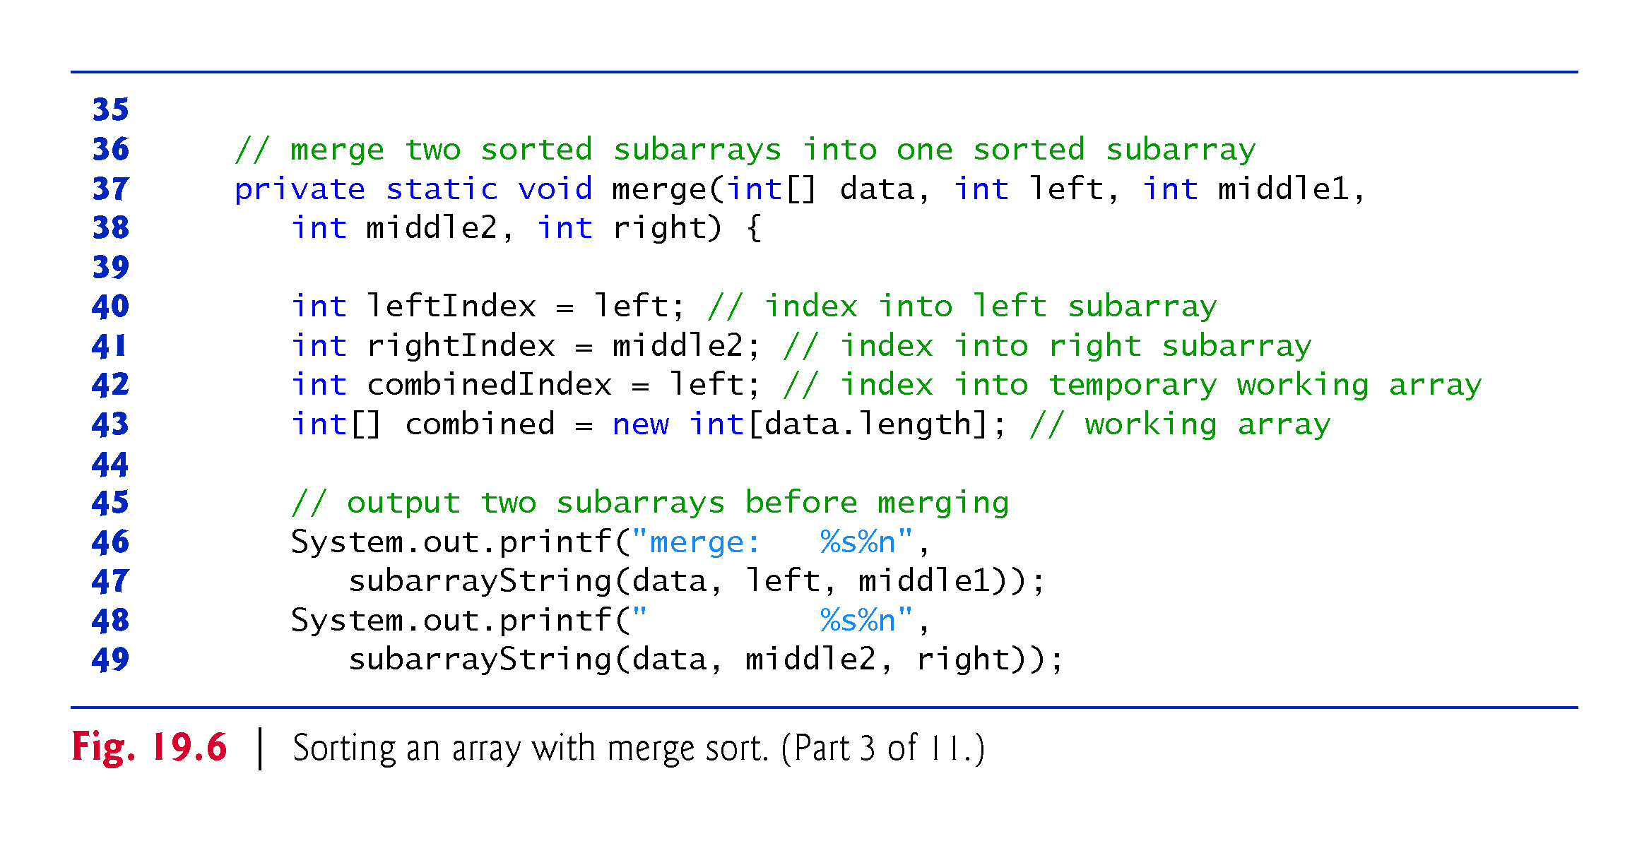

Slide 49
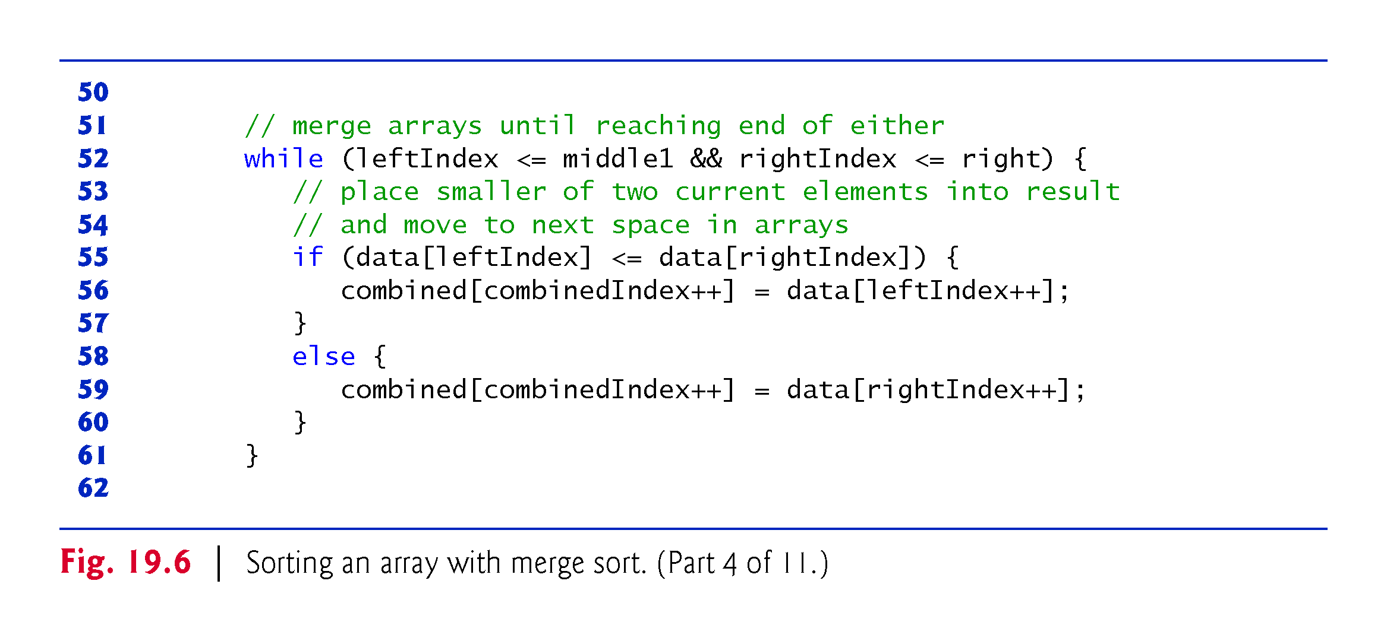

Slide 50
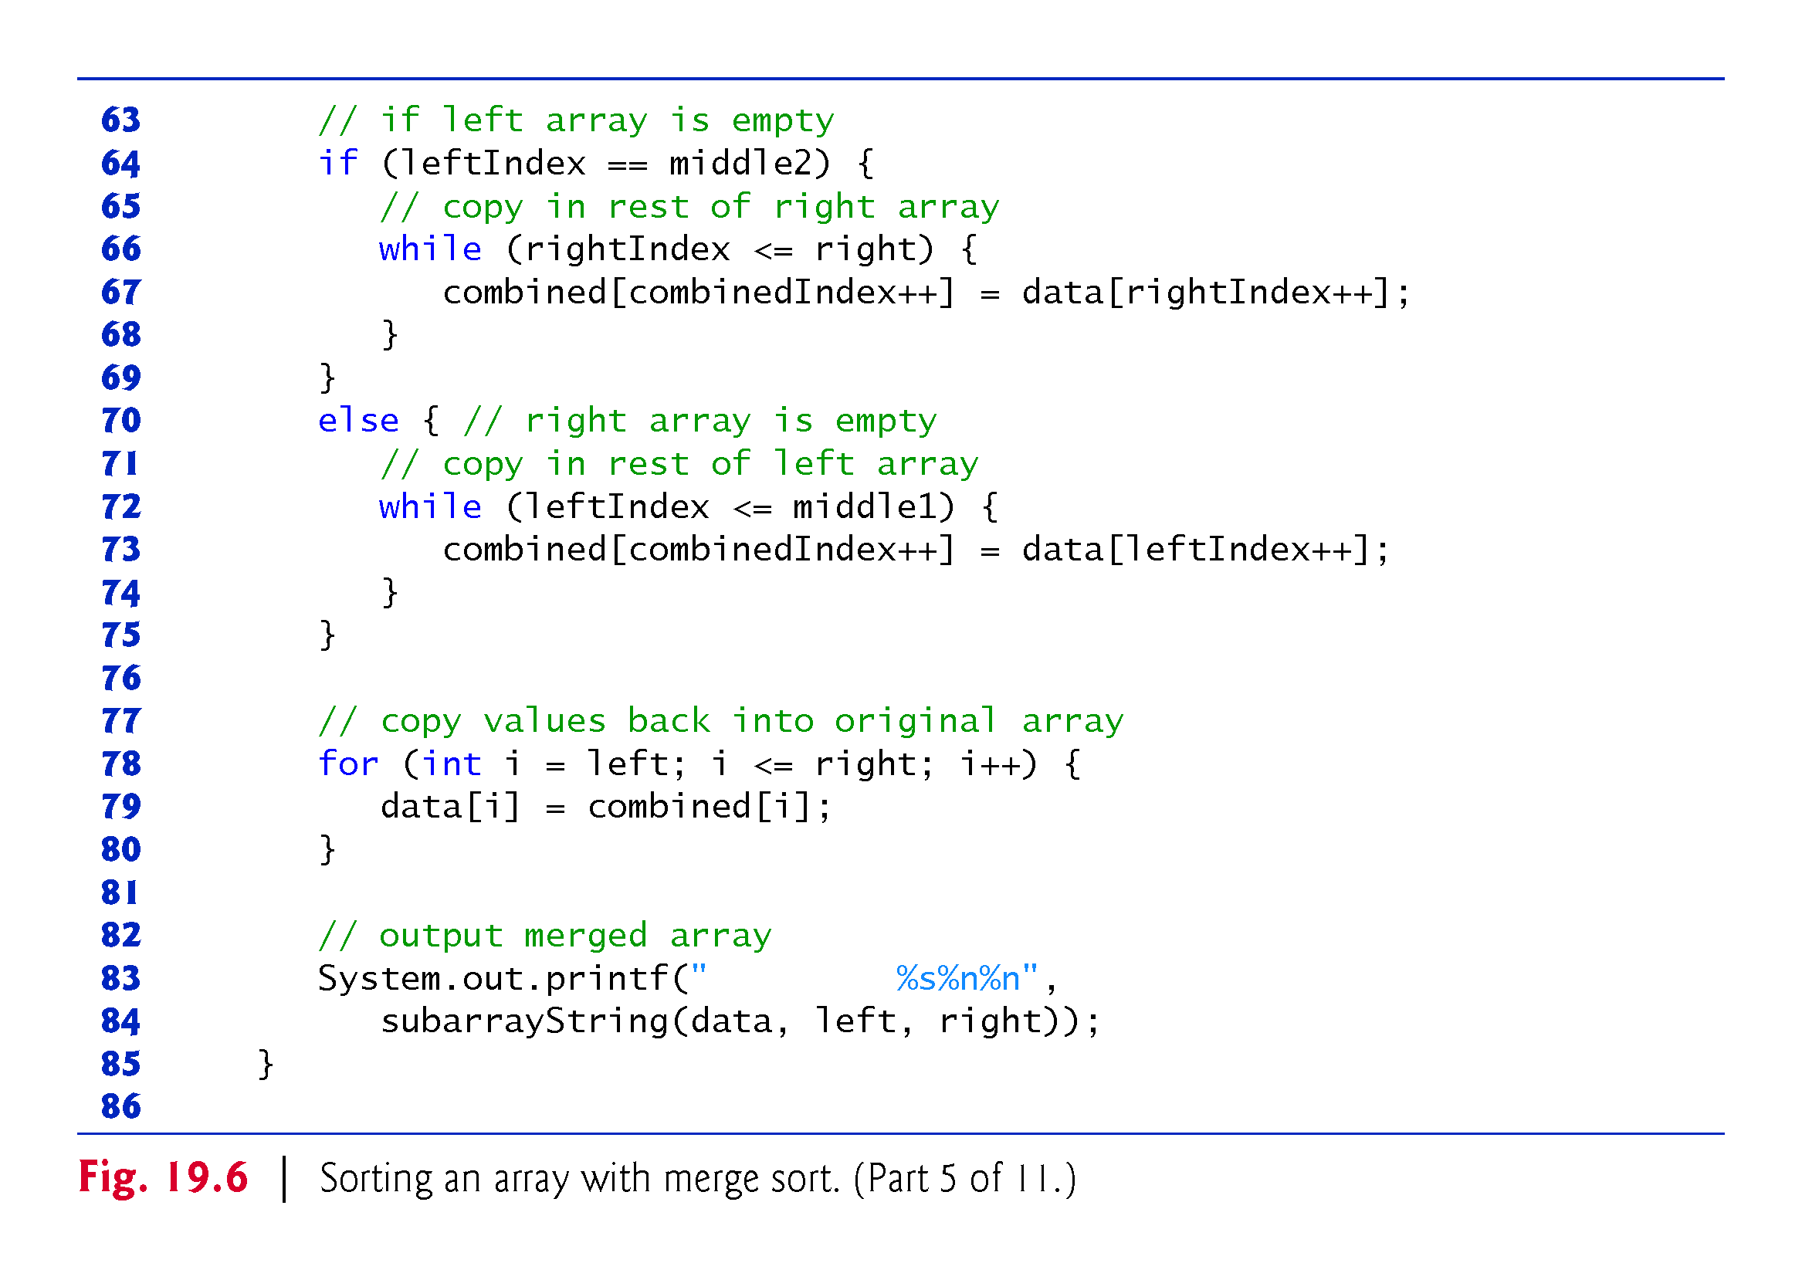

Slide 51
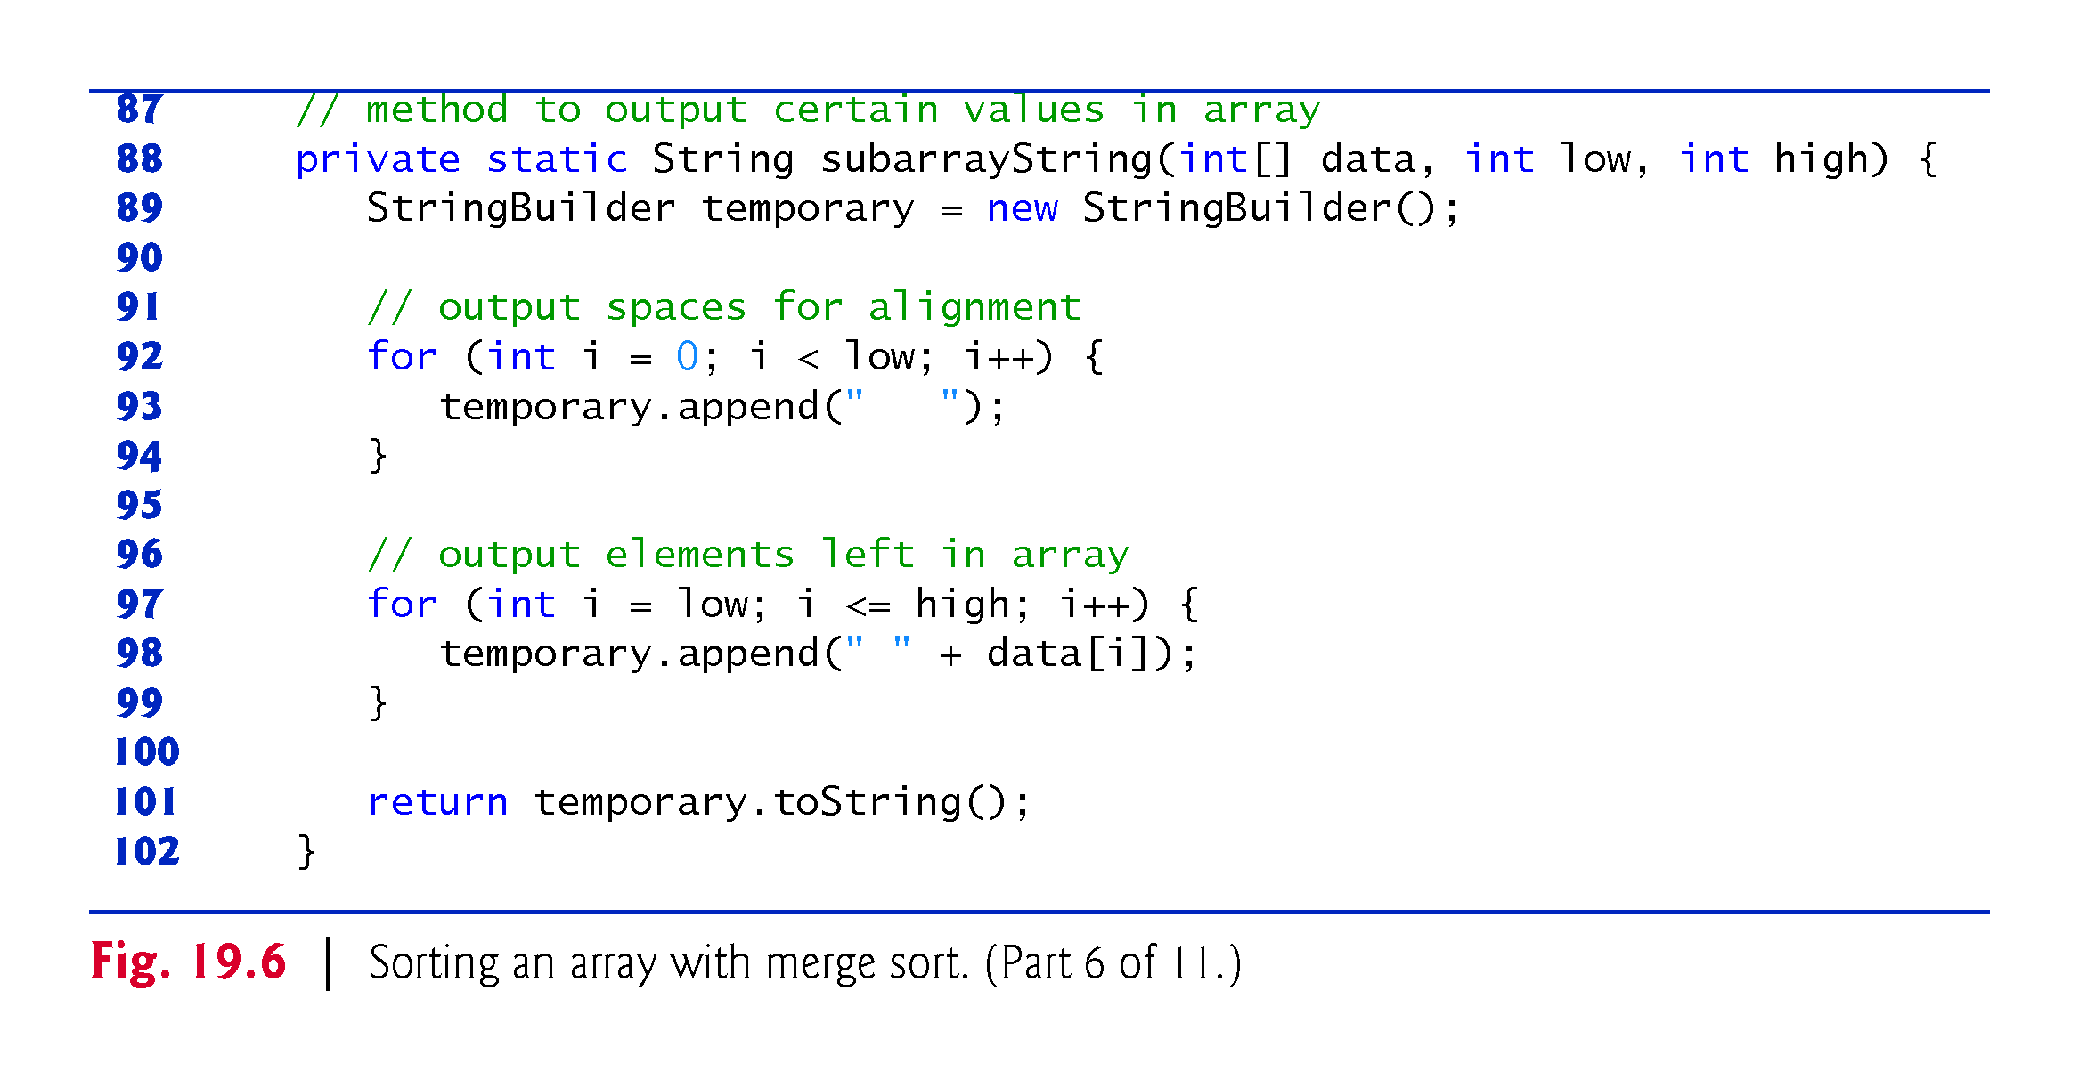

Slide 52
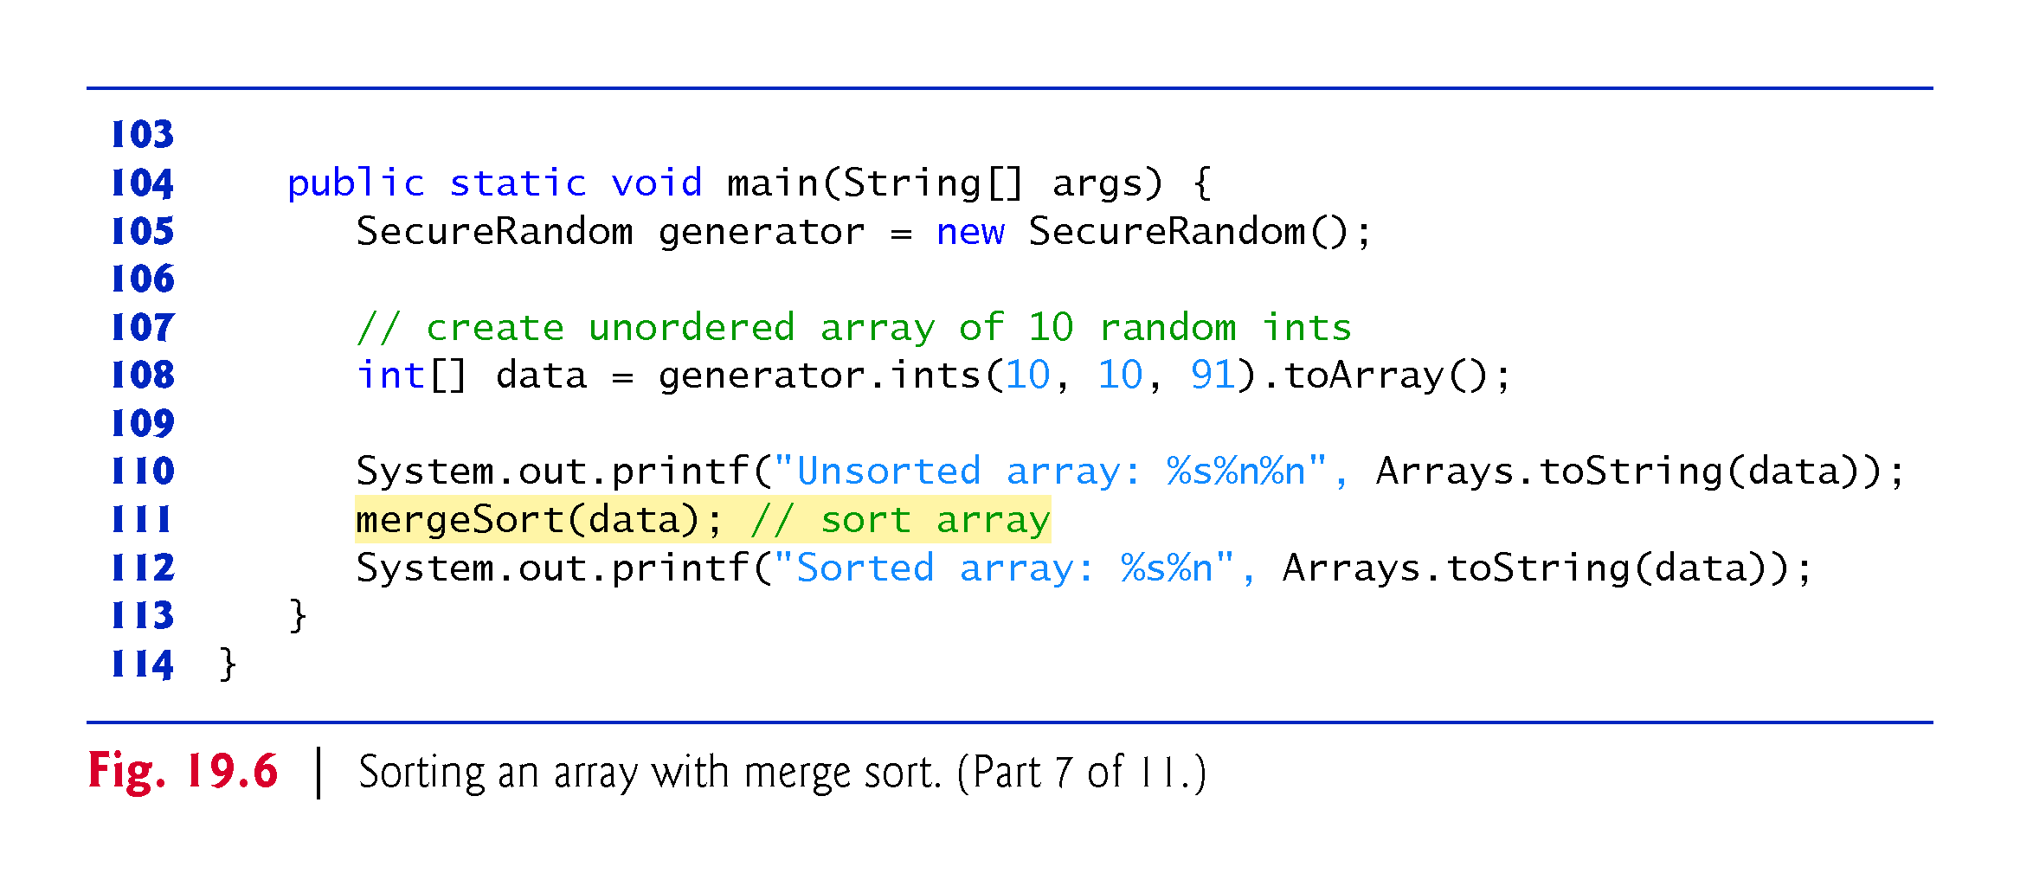

Slide 53
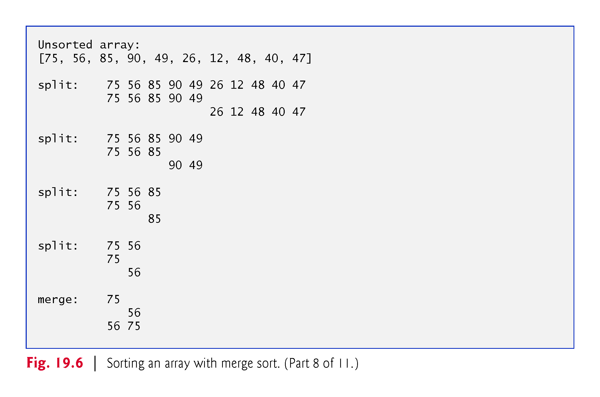

Slide 54
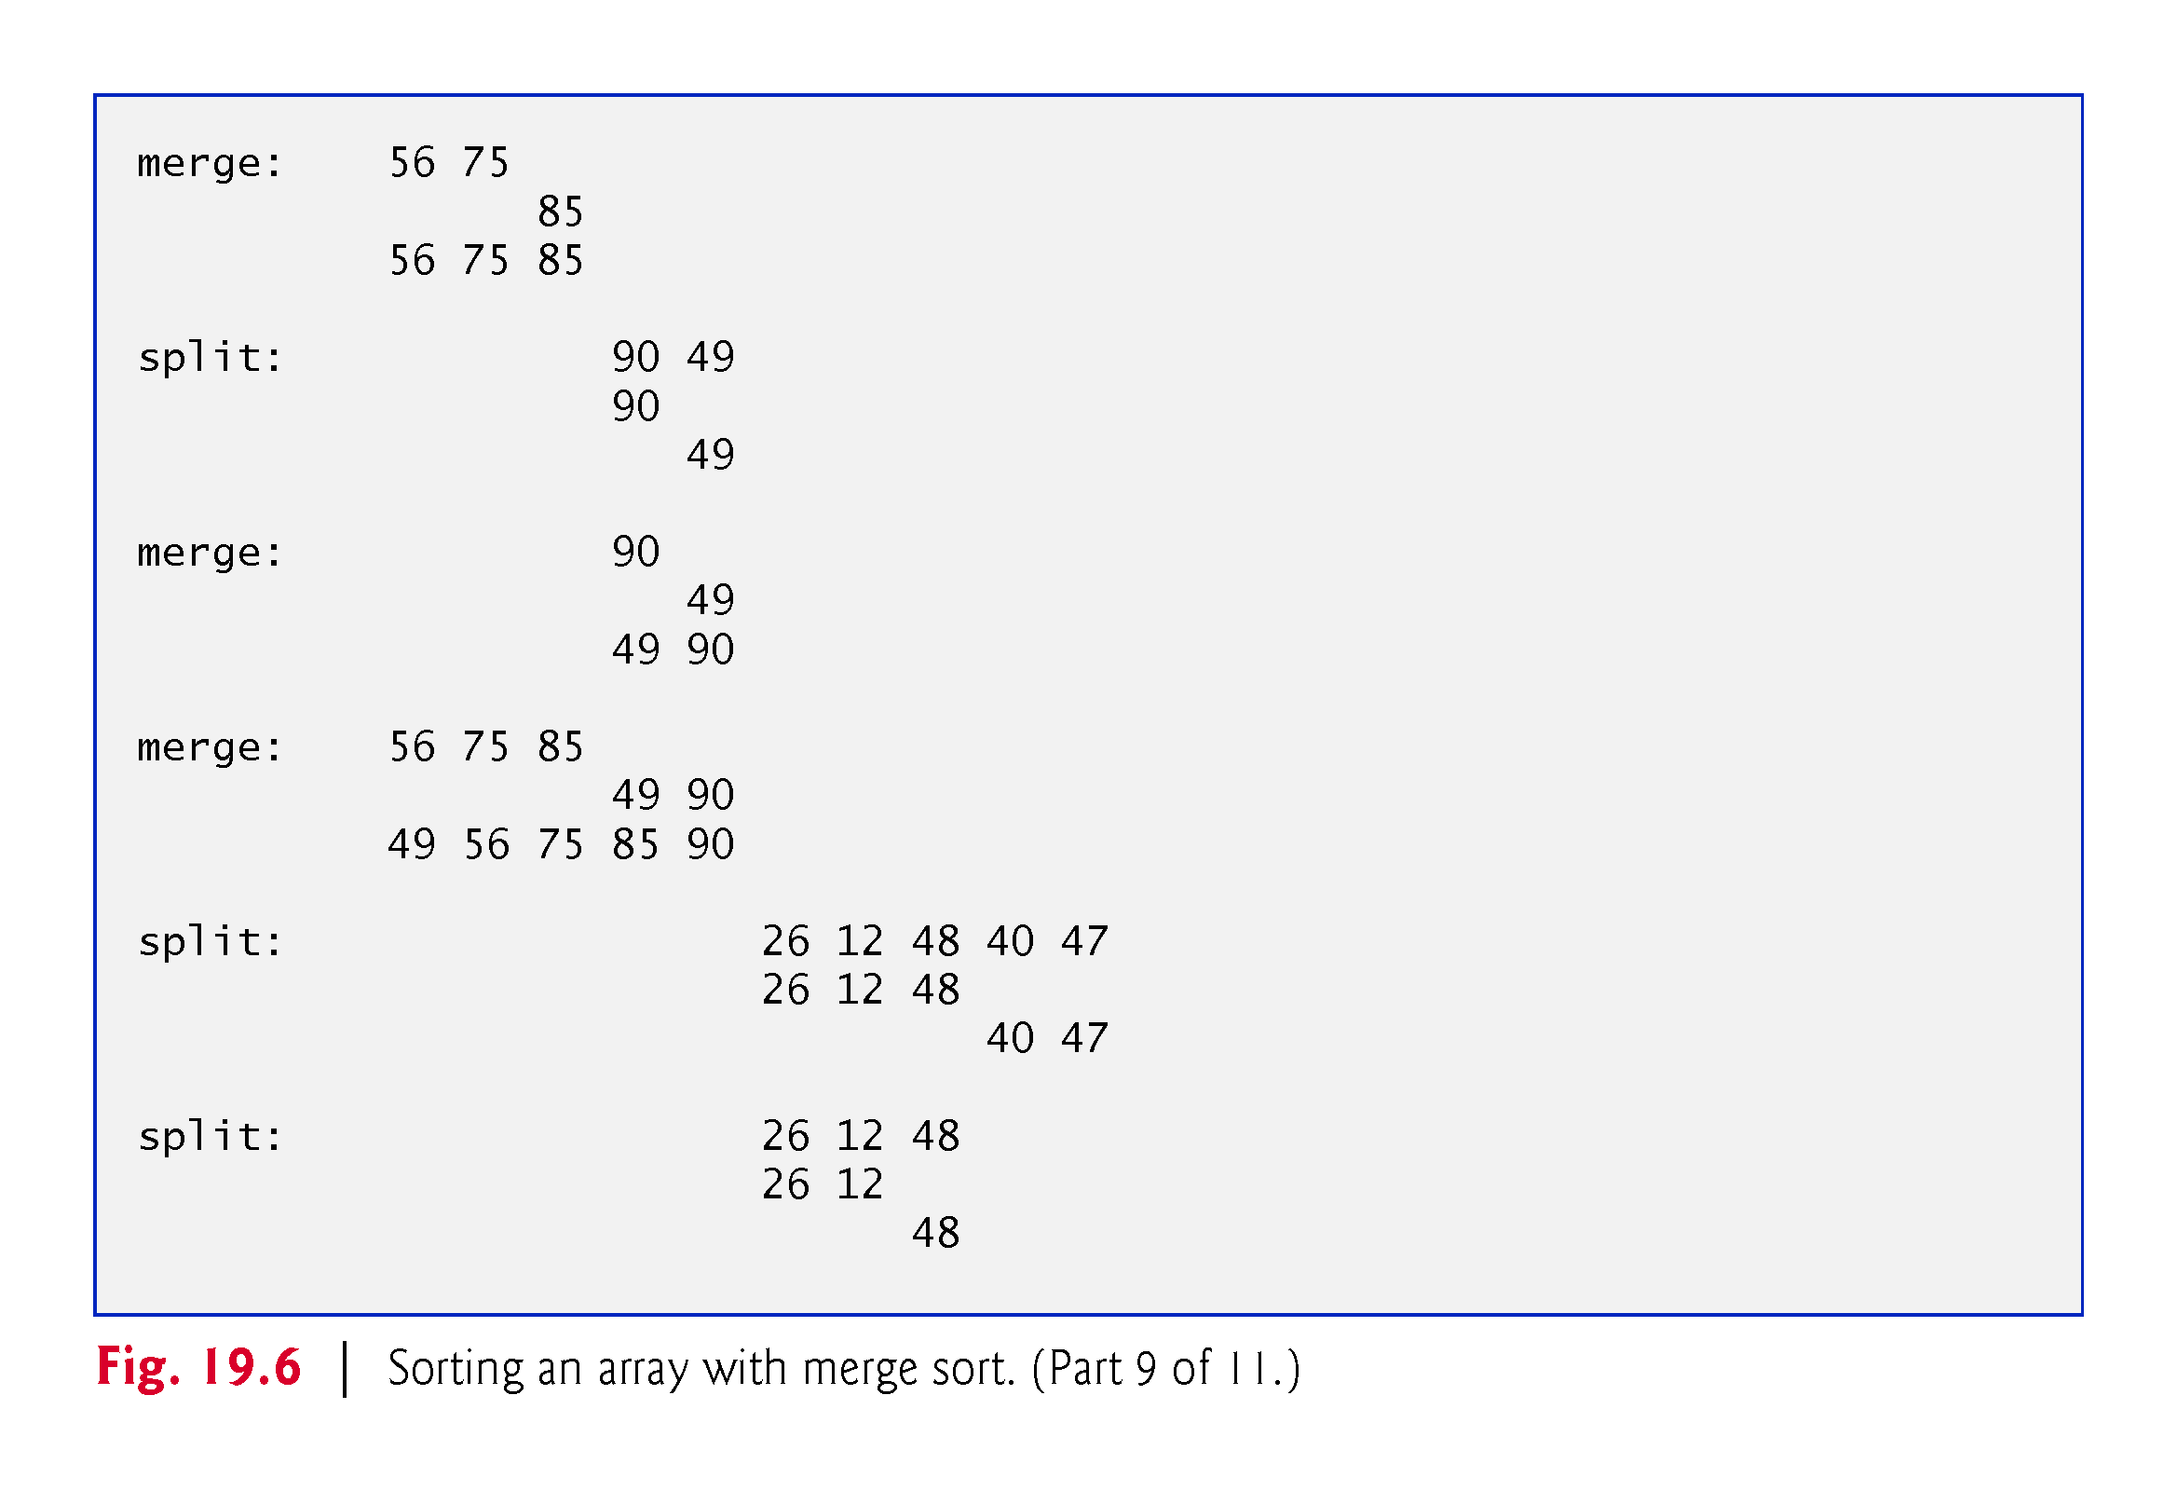

Slide 55
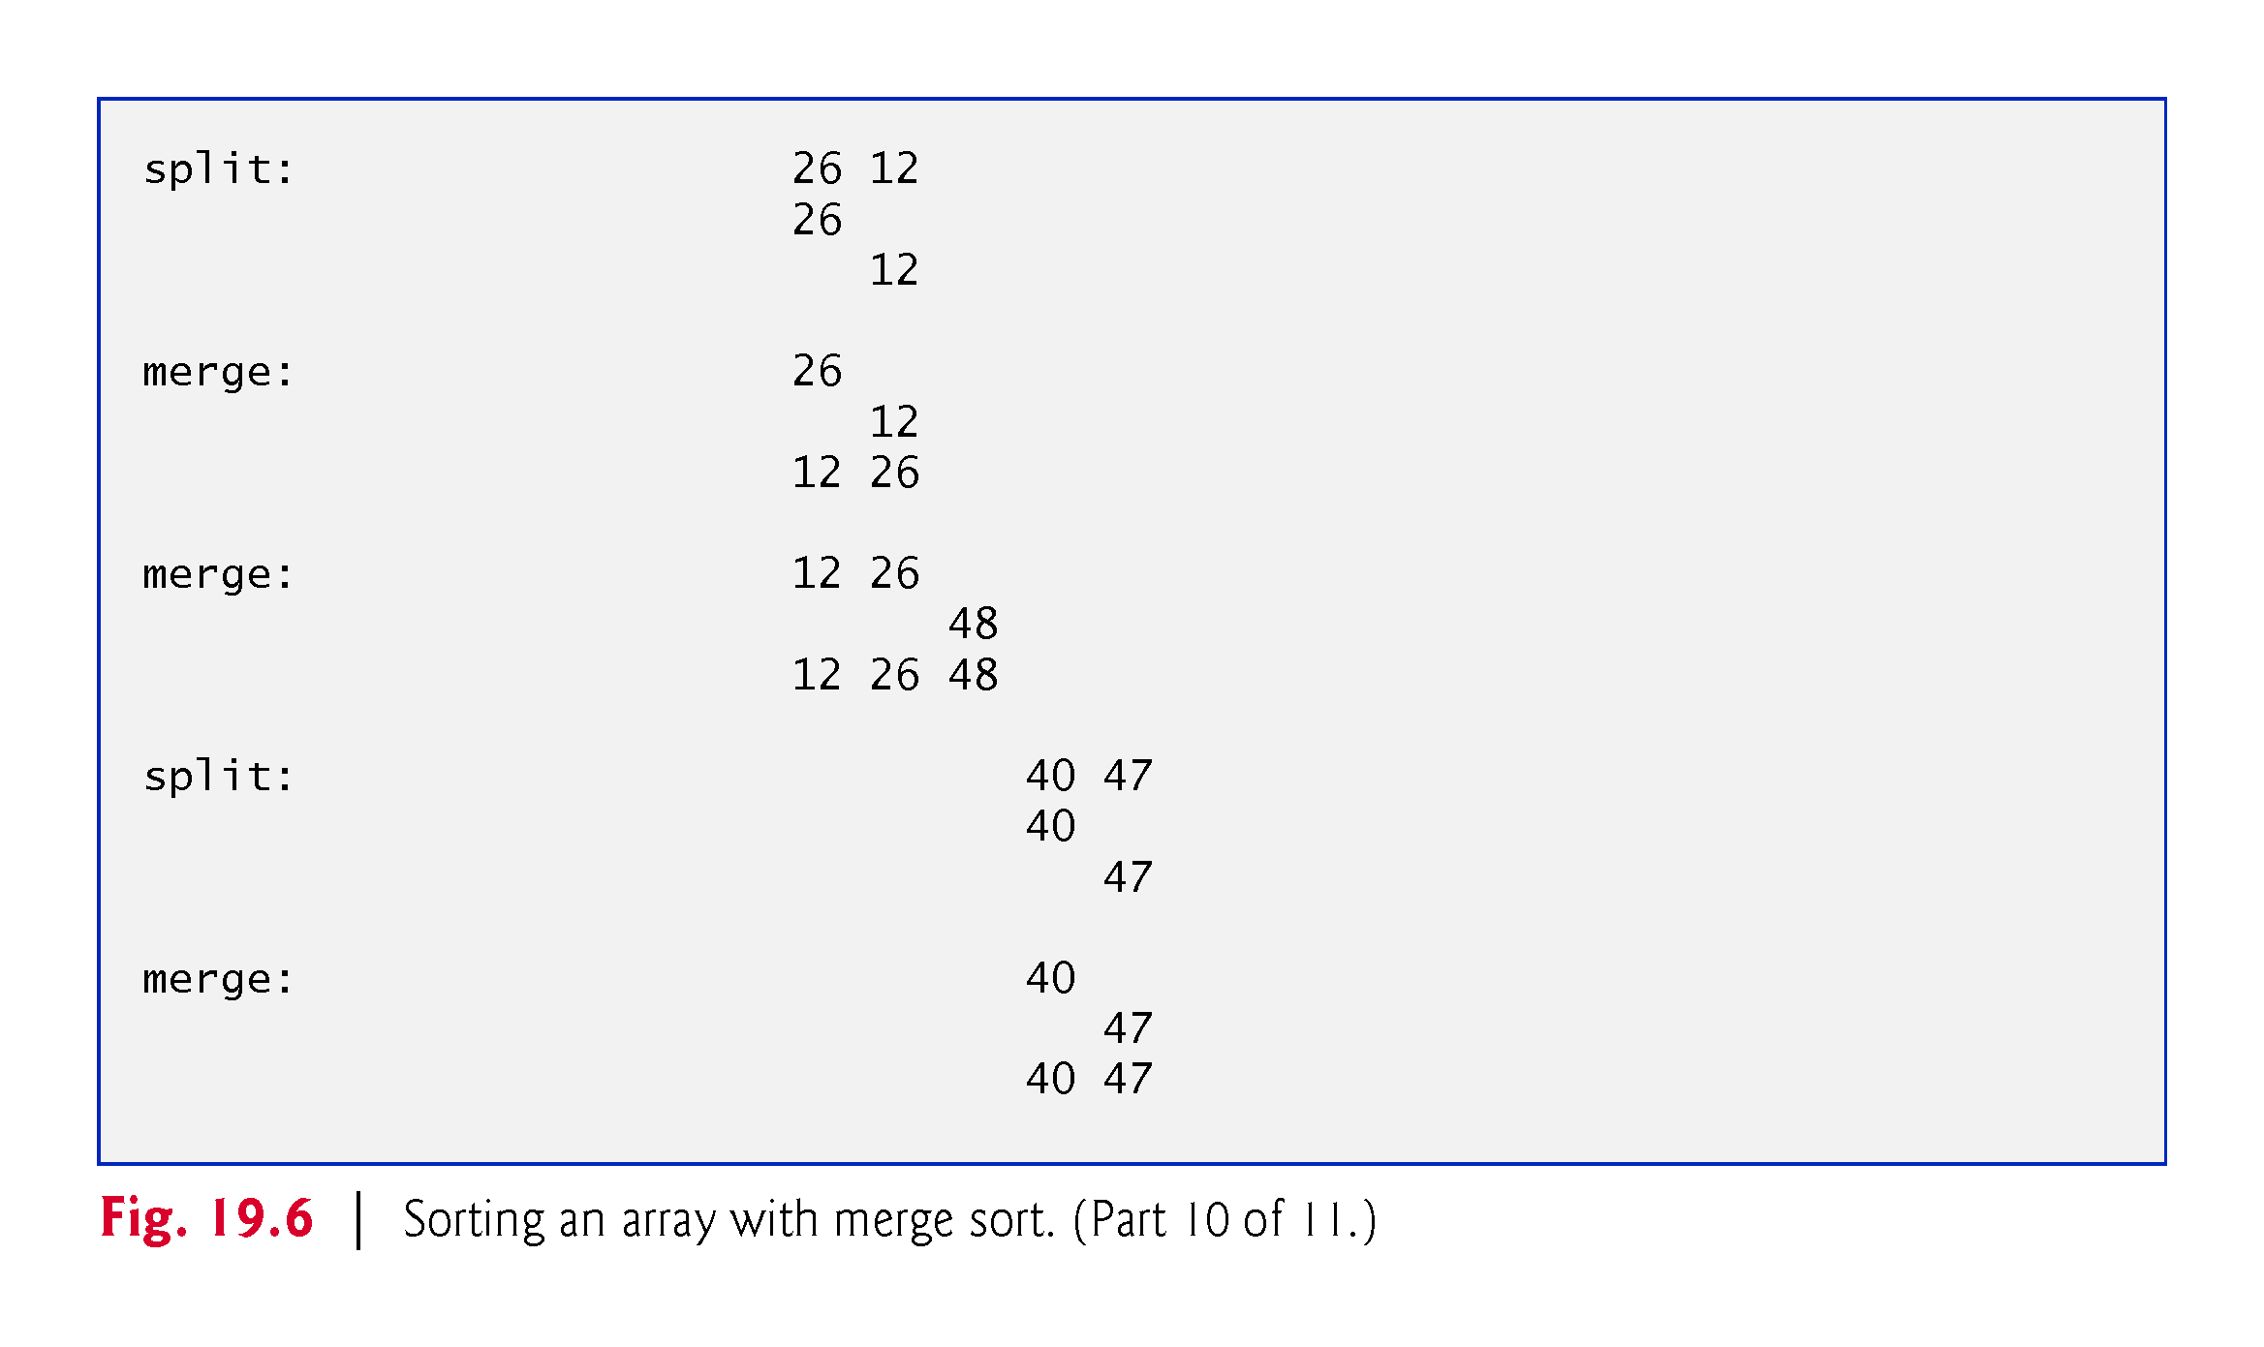

Slide 56
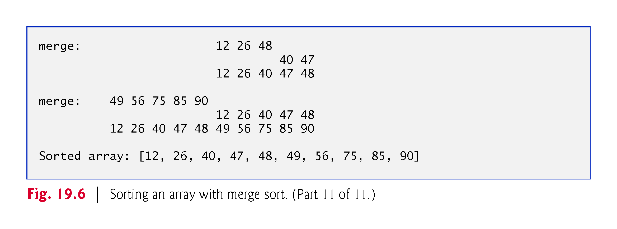

Slide 57
19.8.2 Efficiency of the Merge Sort
The merge sort is far more efficient than insertion or select sort.
The merge sort algorithm runs in O(n log n) time.

Slide 58
19.9 Big O Summary for Various Searching and Sorting Algorithms
Figure 19.7 summarizes the searching and sorting algorithms with their Big O values.

Slide 59
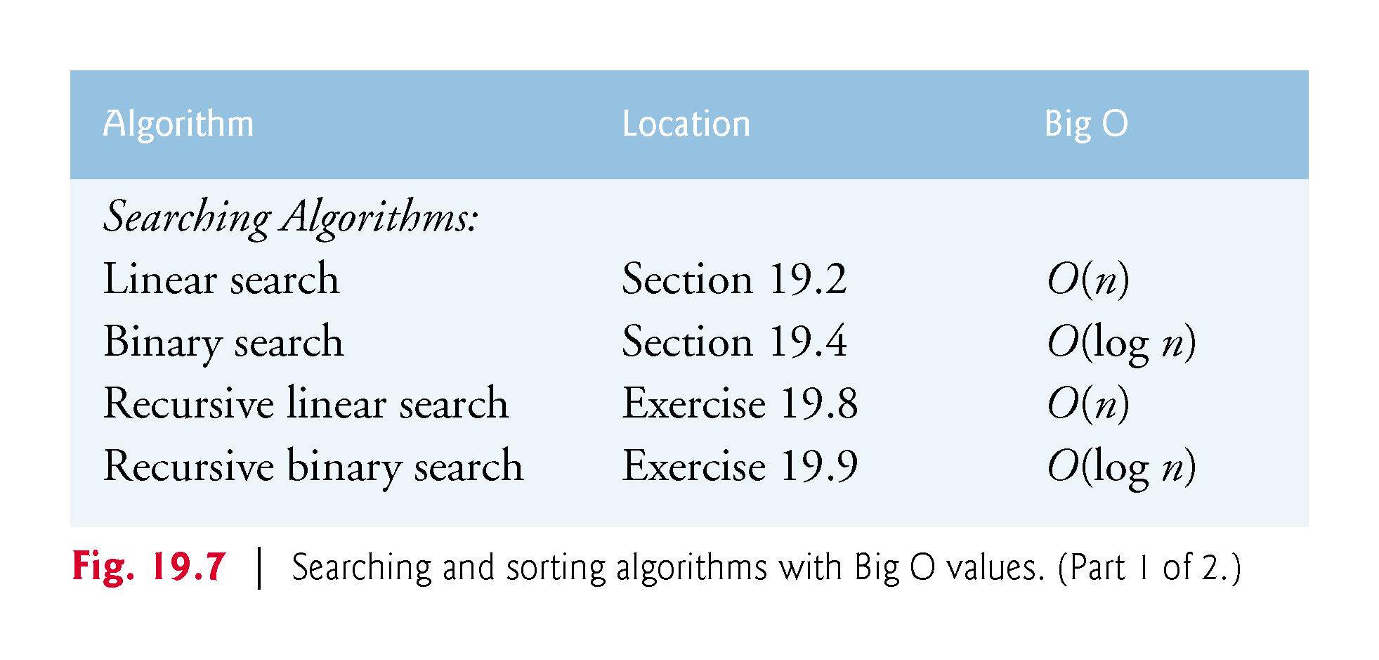

Slide 60
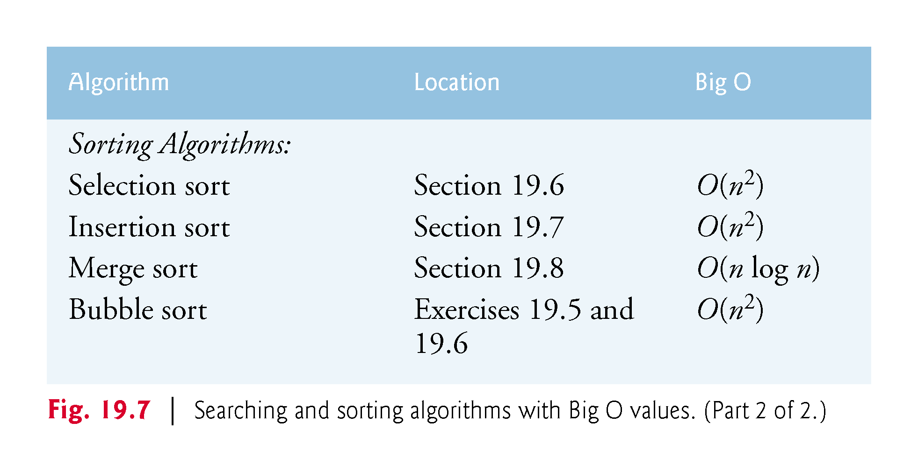

Slide 61
19.9 Big O Summary for Various Searching and Sorting Algorithms (Cont…)
Figure 19.8 lists the Big O values we’ve covered along with a number of values for n to highlight the differences in growth rates.

Slide 62
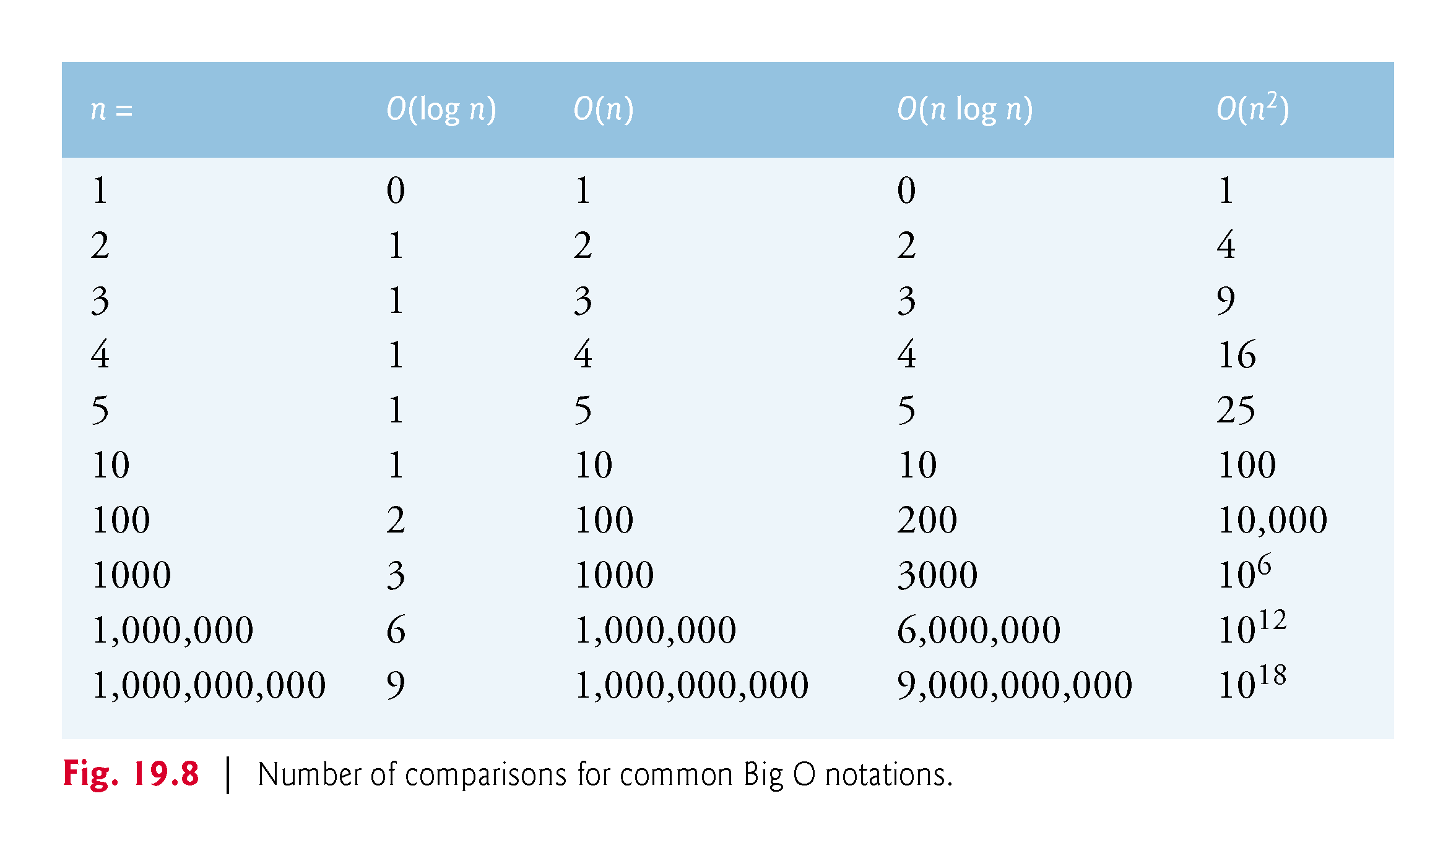

Slide 63
Chapter Objectives – What we covered
Describe how to search for a given value in an array using linear search and binary search algorithms.
Describe how to sort arrays using the iterative selection sort, insertion sort and recursive merge sort algorithms.
Determine the efficiency of searching and sorting algorithms.
Identify the Big O notation for comparing the efficiency of algorithms.

Slide 64
Questions?

